Slide 1
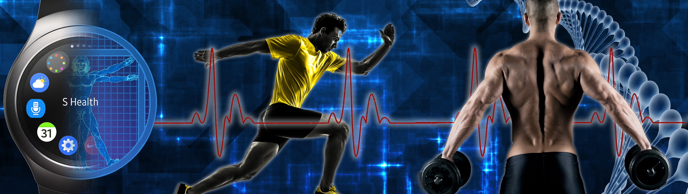

Fitness 360
Motionsoft Technology Summit
Jeffrey Cooper
Sr Manager Business Development
Notes:
Role of technology intersection with fitness, making it personal
I call it Quantified fitness
As personal Technology becomes ubiquitous and pervasive

Slide 2
A personal story- the quantified guy
2004- 259lbs
In 7 months, dropped 65 lbs to weigh 194lbs
Cycling, running, then swimming, weightlifting with 3 months with a personal trainer
Notes:
This is my personal story, starting in 2004

Slide 3
This is how I did it in2004-5
Notes:
I ran and cycled on my own, and then joined Life Time Fitness in Dallas.
Due to the technological limitations of the day, I used Excel to track time and used formulas to estimate calorie burn.
I added a Garmin Forerunner in late 2005
I went from barely being able to run a mile to completing a Half Marathon within 2 years

Slide 4
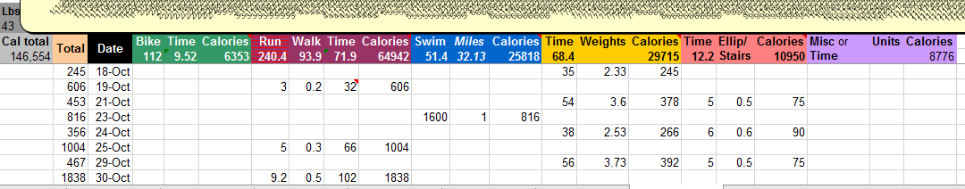
Was it worth all the fuss?
Yes
Notes:
I’m a metric-driven person, so it was worth the fuss. The visualized trends and the results motivated me to continue down this track for years.

Slide 5
Work & Philosophy
Samsung Electronics, Content and Services
All things flagship, from phones to watches to TVs and Signage to Smart Fridges (and more)
Work with total solutions that work seamlessly across as many devices as sensible
Fitness & Health focused
No fuss solutions- they as touchless as possible and “just work”
Privacy and Security must be respected and access to personal data must be opted in.
Notes:
Where I am situation in Samsung and what I work on
My technological and application philosophy
Passion for fitness and health

Slide 6
Personal Fitness and Fitness Clubs
Member of various gyms over the years- Bally’s, Life Time Fitness, 24 Hour Fitness (current)
Avid runner
Despite my fondness for fitness, I still fall short due to human trappings
  “not enough time to go to the club”
  “tired”
  “I’ll go tomorrow”
  “it’s hot out” or “it’s cold out”
  And so on…
I have to work hard to find ways to motivate myself and outsmart my myself
Notes:
You can have fitness goals, but fitness is a lifelong journey.

Slide 7
Health Awareness at an all time high
Health awareness is as high as it has ever been, but up to half of all Fitbits end up in a drawer^{(JAMA)}, and obesity rates have stayed the same.
Club memberships have risen at a CAGR of 3.5% ^{(Statista)} since 2000
37% of adults consider themselves overweight ^{(Gallup)}, but 68.8% are actually overweight ^{(NIH)}
The average American has gained 24lb since 1960 ^{(stateofobesity.org)}
Notes:
I take my personal story and apply it to the present- obesity, chronic illness and health are in the news constantly
More than ever we are able to track what we do
But we don’t, or not for very long.

Slide 8

Membership Cycle
Duration of time
Up for renewal
Sign up
35-45%
cancel
Source: IHRSA
Notes:
You see a reflection of this in your clubs. People join and then nearly half underuse the facility and eventually drop out.
Year in, year out, club membership churns. Up to 50% are long term (>3 years) members, but the rest is churn, with most of it occurring annually when the initial 1-year agreement is up.

Slide 9
By the numbers
30%
Not using my club membership
17%
Club too crowded
21%
Lack of guidance or knowledge, felt out of place, intimidated
46%
Perceived Low Value
>5x
Acquisition cost vs retention cost
Source: Statista
Notes:
Reasons people quit their club memberships

Slide 10


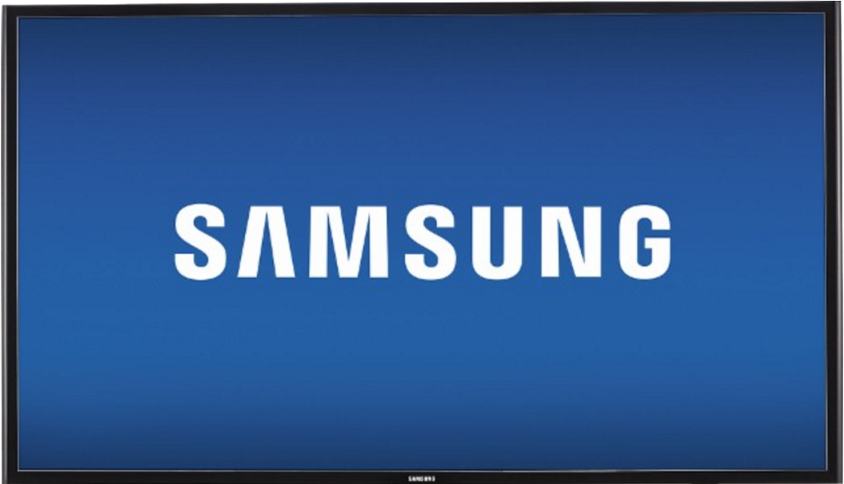
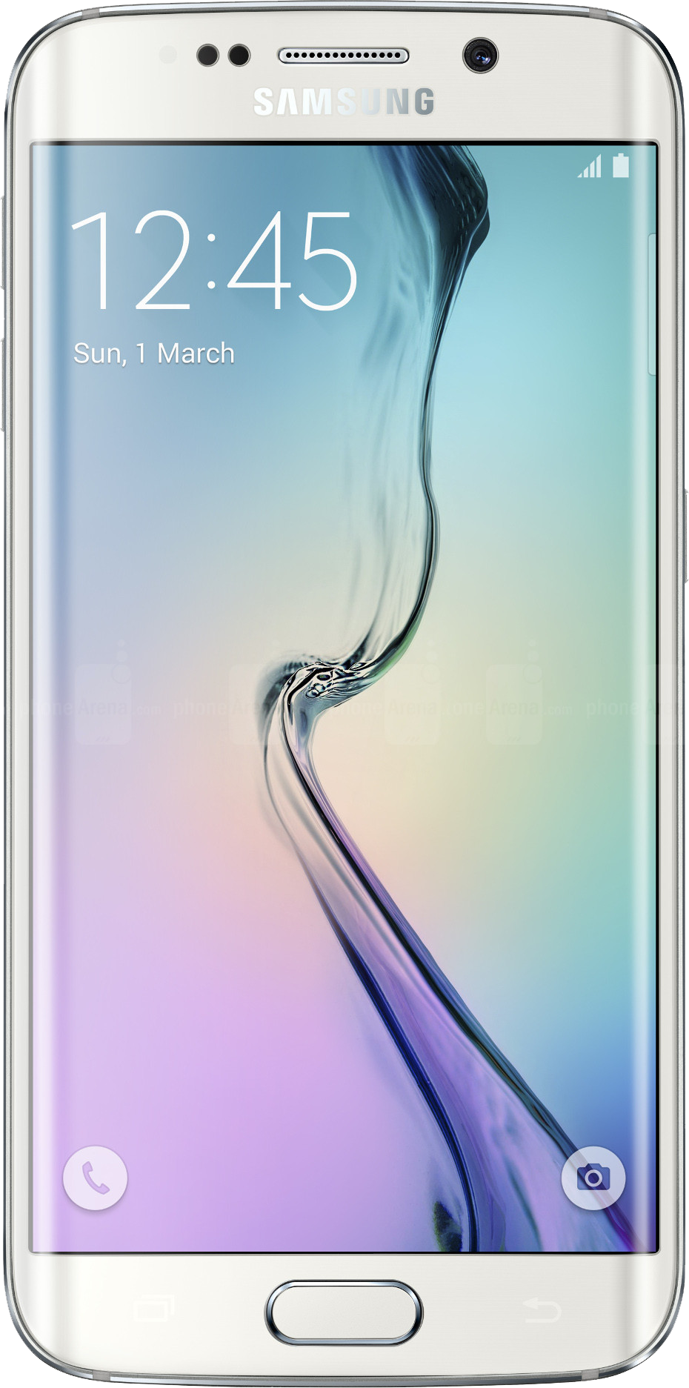
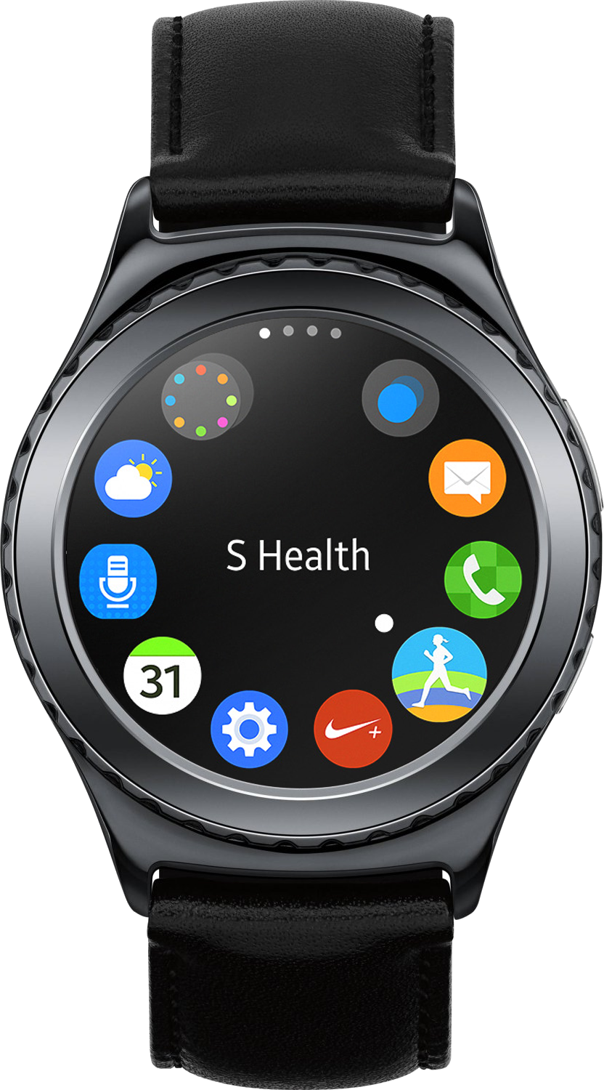

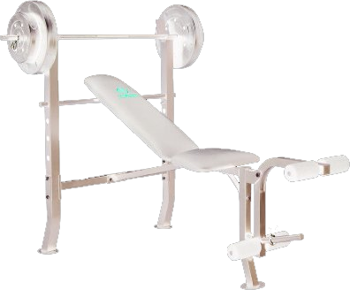
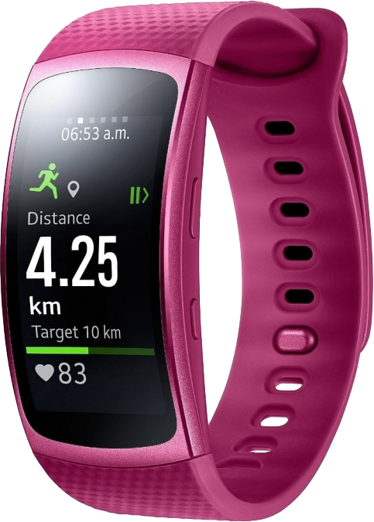


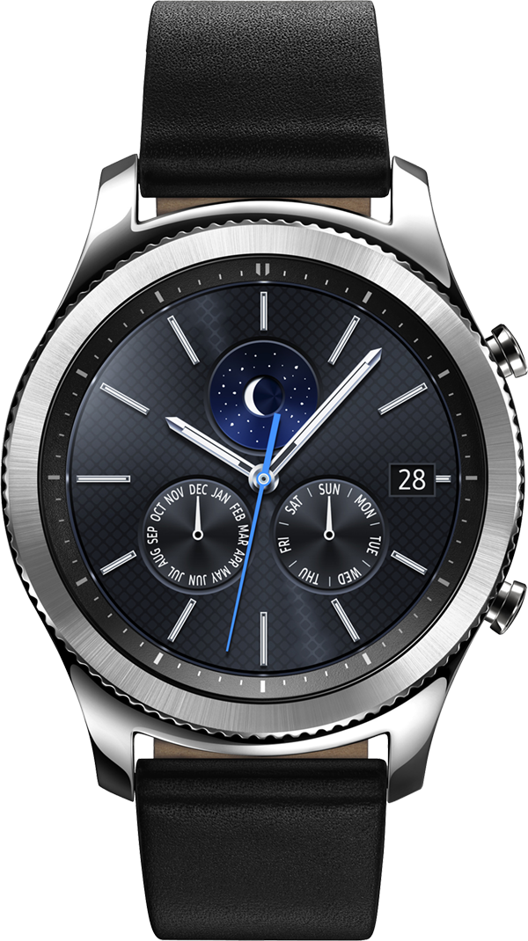
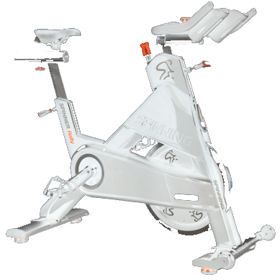
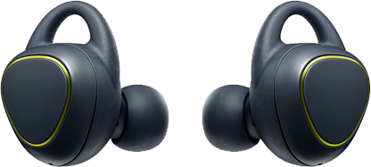
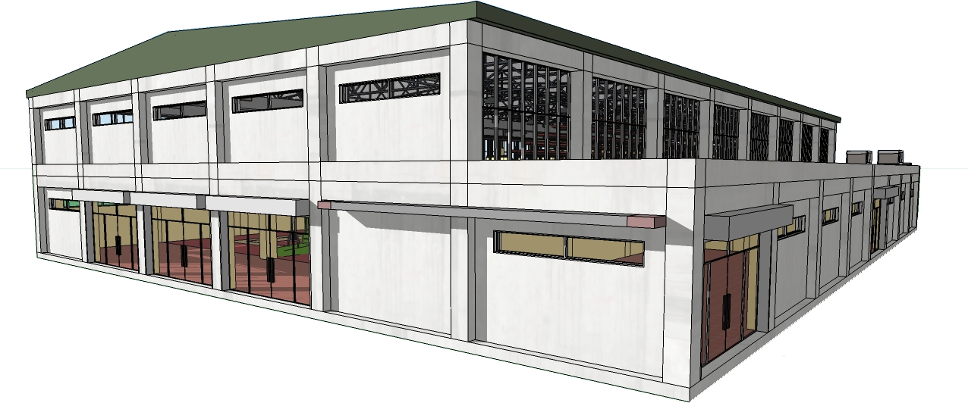
Snapshot of the present
Notes:
Today we are awash in connected, personal devices.
Clubs are full of largely disconnected equipment (even if the console is connected to the Internet, most machines are not connected to the user). Club may or may not have TVs or digital signage.
Clubs have not kept pace (for various and many good reasons)

Slide 11
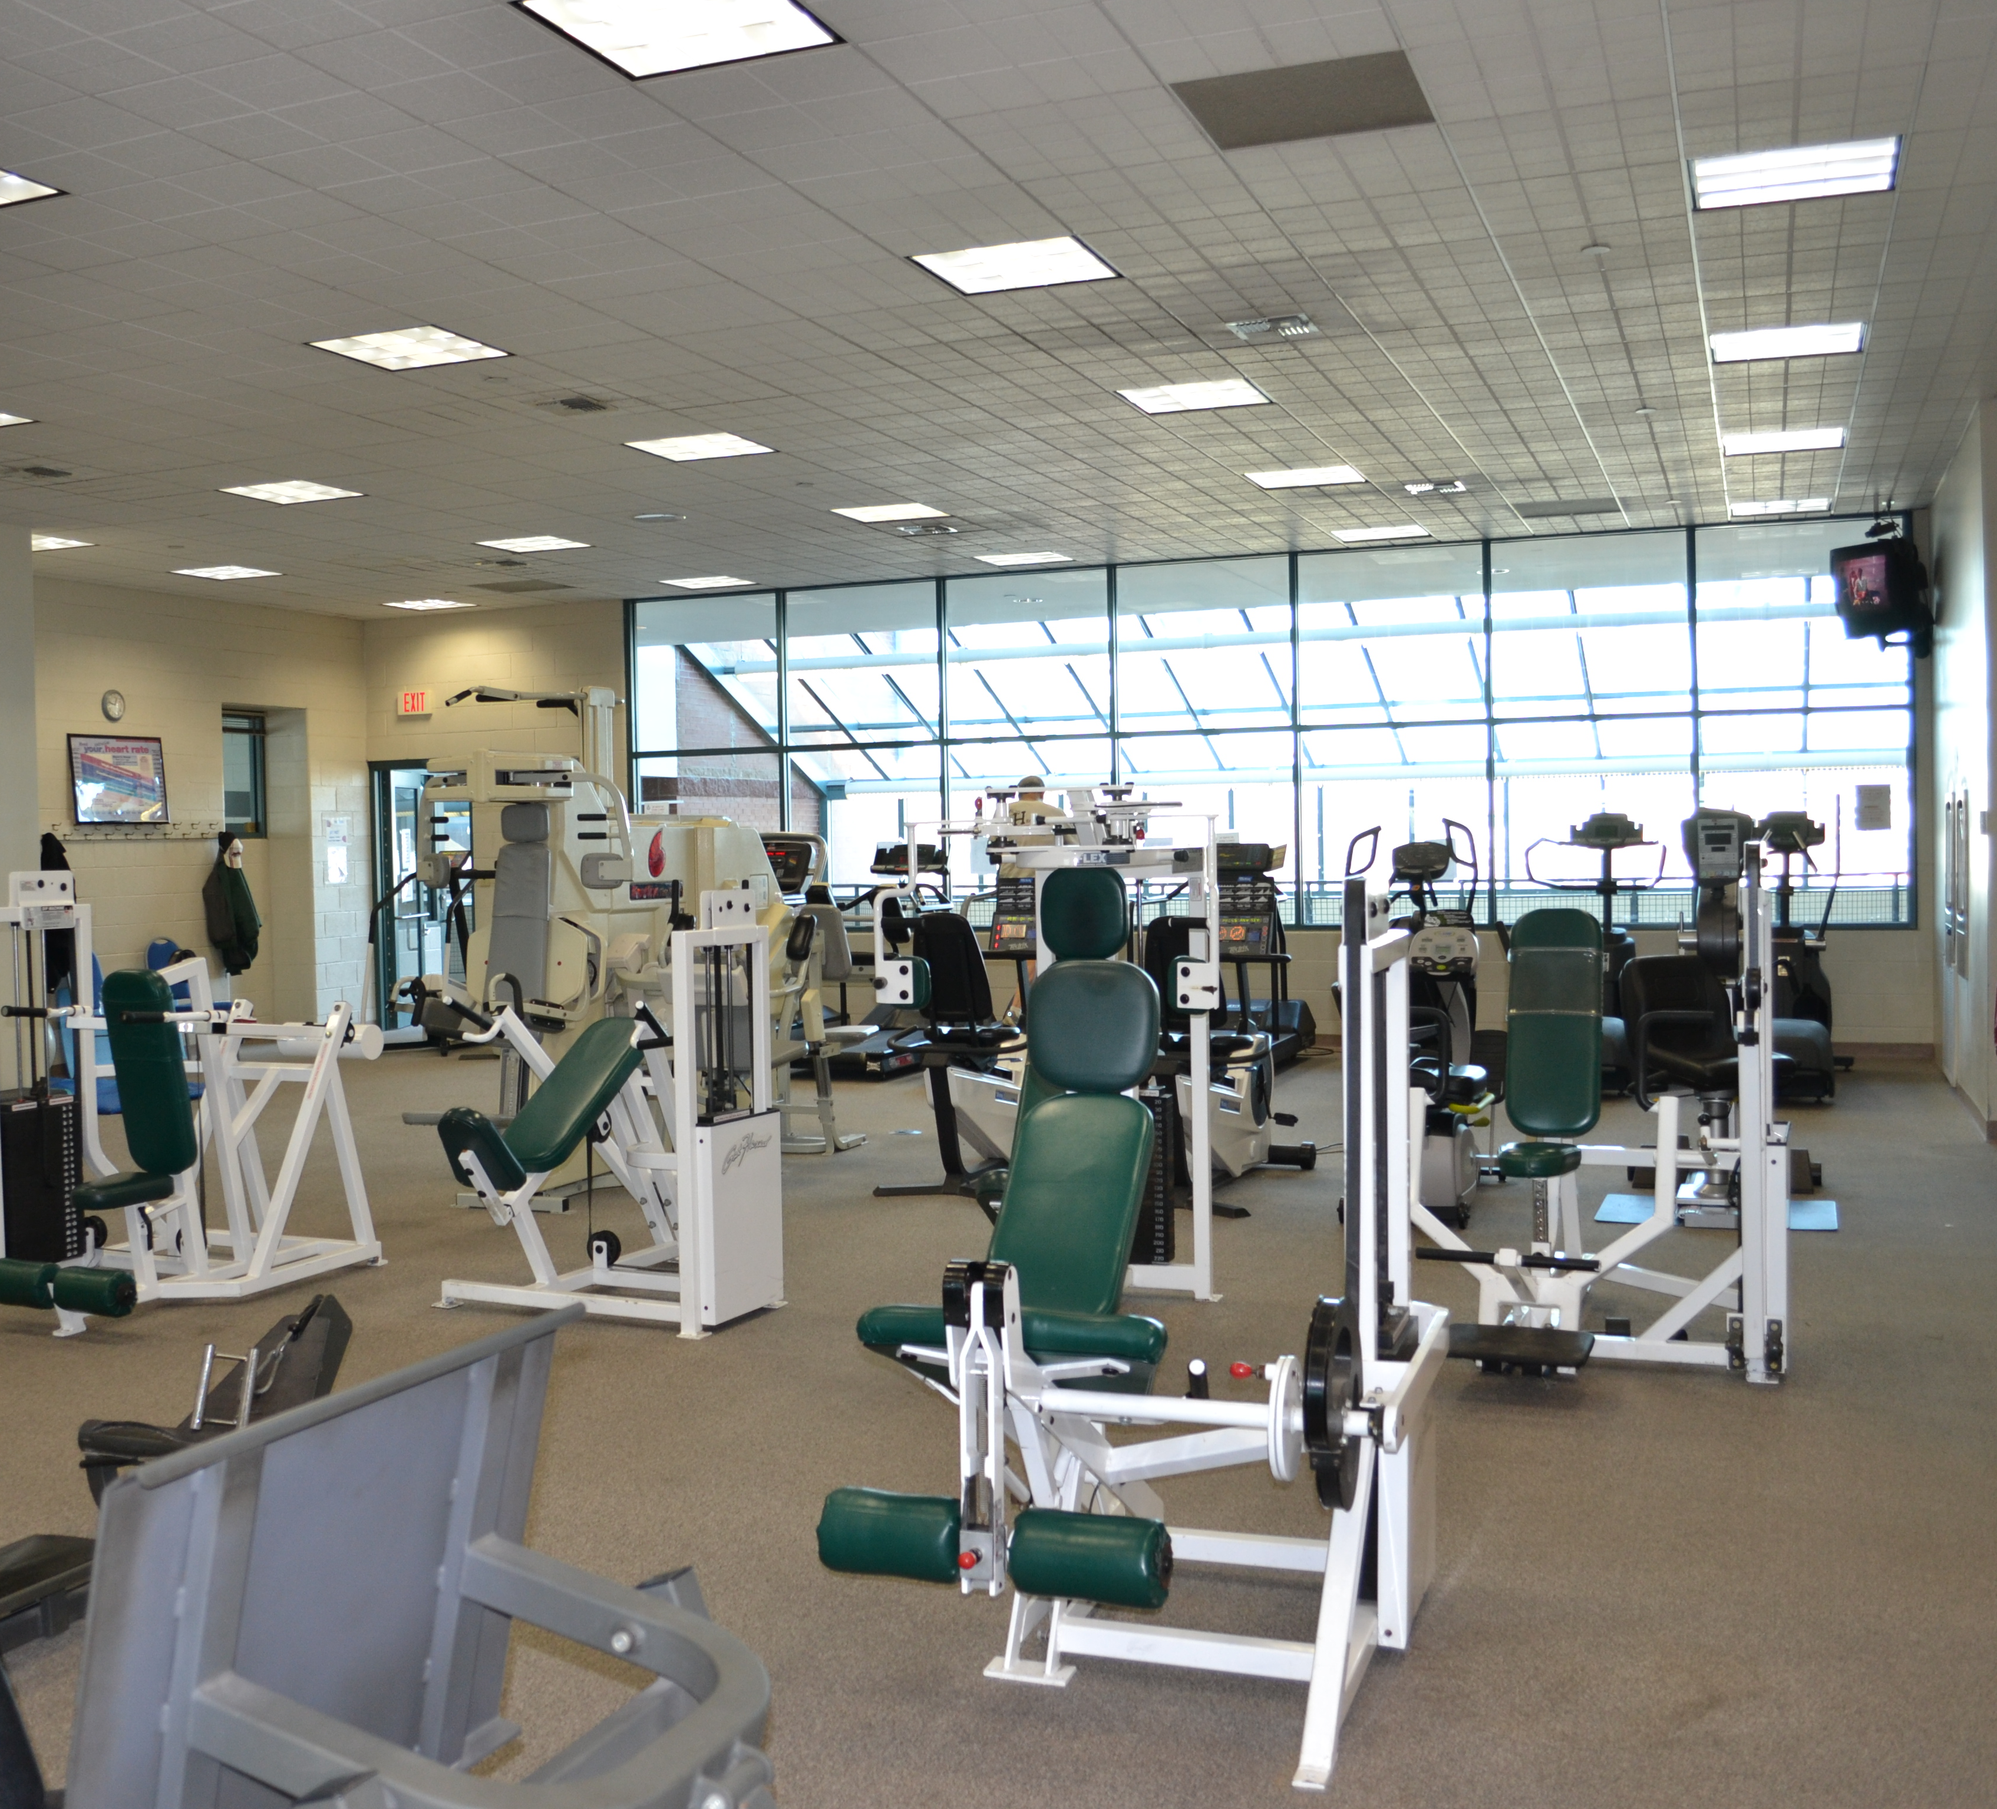
Today
Club, home and work are independent of each other.
Notes:
The state today…

Slide 12

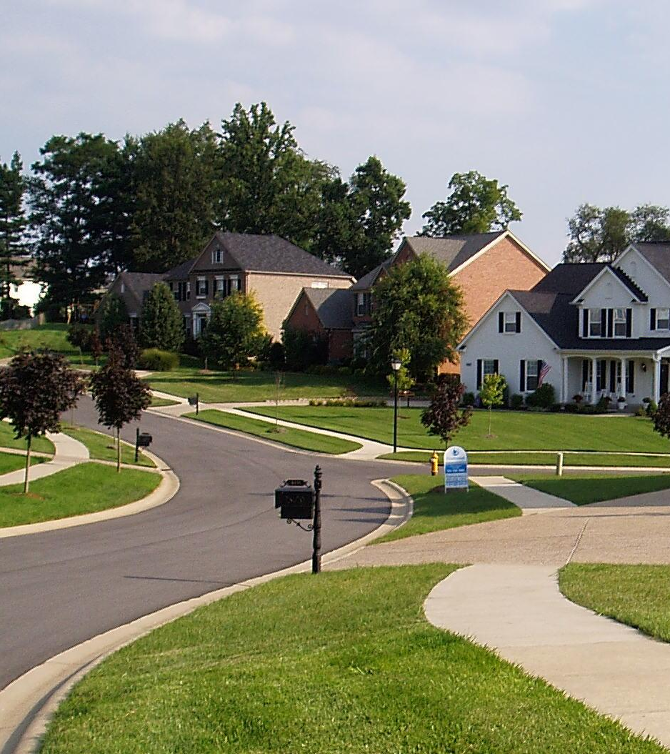
Daily Activity
…from steps to stairs, sitting, eating, sleeping and @home exercise such as running and cycling are completely missed
Notes:
Including running and cycling.
Sometimes, this data is connected via a mobile app, it is frequently not visible on club website, and hence no visibility to the club for analytic and coaching purposes.

Slide 13







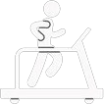
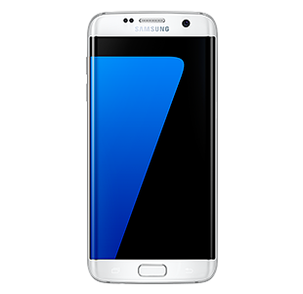
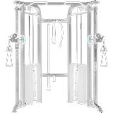

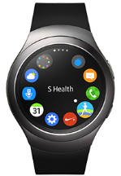
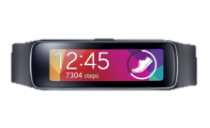

@Home, Work
@Club
Member
Management
Fitness Clouds
Trainers
Weights &
Machines
Group
Notes:
Currently people use various apps to capture runs, rides, and if they use apps to track food or a wearable for daily activity tracking, it is kept in its own silo.
People are better connected outside the club than they are inside the club.
Any activity done at the club is generally unrecorded and is lost data, and hence, lost opportunity.

Slide 14
Areas of ROI for the Club
Incremental Revenue
Margin Improvement
Member Value
Offer new services
Improve facility use & efficiency
Accurate accounting for classes
Proactive management
Low cost, value added services
Member rewards for behavior that benefits facility
Better member engagement = happier members
Upsell club offerings
New partnership opportunities
Notes:
What I want to talk about today is how to use technology and the data it provies to improve revenue.
By having additional data on your members, you’ll be able to start looking at ways to increase overall revenue of the club

Slide 15
A typical week in your life- by hours
Commute
5
Club
4
Other
63
Work
40
Sleep
56
Notes:
Here’s a typical week in your member’s life

Slide 16
Club view of your week
Not club
164
Club
4
Notes:
This is how the club sees a member’s life.

Slide 17
What if…
Relaxed
7
Exercise
4
Club
4
Commute
5
Sedentary
36
Not club
164
Walking
7
Active
4
Sleep
56
Work
40
Club
4
Stressed
16
What could that week look like to a club?
Notes:
What if you could see how a member’s life is through an activity lens.
Any wearable device the member has will generate data that can be used, that combined with other phone data can give the club a deeper view of a member’s activity profile.
See sleep data, see time at work and break it down into active and sedentary.
During a week, how much time was spent walking and perhaps running?
How about stressed vs relaxed?

Slide 18
Use the phone you have
Health repositories on phone store data from outside the club
Club data copied to on-phone repository
All data resides with member data @Club
Typical schedule and calendar can be gleaned from device
Half of club members use their phone while working out
How do you get there?
Notes:
First, there’s our phones. S-Health has a rich repository of information and actually works on all Android devices. When no wearable is used, S-Health behaves like the Moves app. For non-Samsung or Android phones, your app can use data from the local health repository.
Knowing basics such as where work is, work hours, and schedule can help suggestion engine for activities and gym visits. Privacy is respected and data is at a coarse granularity level.
Getting data from the member’s phone is easy if you have an app

Slide 19
Consider a smart wearable
Feature | Gear S2 | Gear S3 | Gear Fit2 | IconX
Pedometer
Continuous HR
9-axis accel/gyro
Altimeter
Barometer
GPS | (3G model)
WiFi
Cellular | (some) 3G | (some) LTE
NFC (passive)
MST (payment)
Gear Fit2
Smart Watches are directly programmable in HTML5 and native C++
Gear S2
Gear S3
Gear IconX
Notes:
Samsung has many wearables. S2 and S3 are comparable, but S3 also features MST for backwards compatibility with older POS terminals.
The cheaper Gear Fit2 contains many of the same features for advanced tracking at a lower price.
IconX have basic tracking capabilities, plus include 4GB of onboard memory for music storage. Ideal for running- run is tracked with HR recorded, music plays, and no need to bring your phone.
Increasingly, these are working with iOS devices as well. Beta tests are in progress now.

Slide 20

Virtual Tracking
@Home, Work
@Club
Member
Management
Fitness Clouds
Trainers
Weights &
Machines
Group
Notes:
To add personal tracking, ideally a gym app on the phone- if you don’t already have it, is a good way to connect the data. Ensure that the data is also available via the website and, therefore, available to the club for analytic coaching purposes.
But, even with this, people are still better connected outside the club than they are inside the club.
Any activity done at the club is generally unrecorded and is lost data, and hence, lost opportunity.
Gathering external activity data is one easy step towards better member engagement.

Slide 21




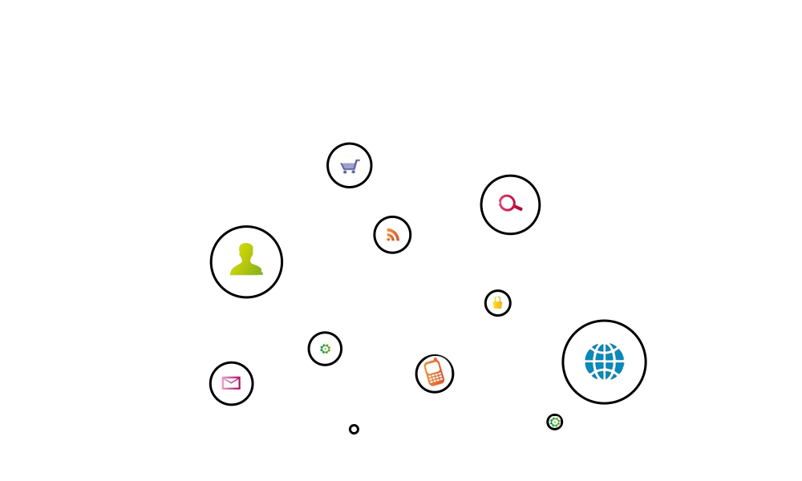
Context and communication connect the two worlds
Context-enabled applications
Notes:
Let’s briefly revisit the present day paradigm
It is possible to use today’s technology with existing equipment, taking context and fusing it with the expertise in the industry.

Slide 22
By adding in a smart watch that can talk directly to club infrastructure and cutting edge technology from partners that runs directly on those devices, you get access to a wealth of new data never before possible.
Notes:
This is a key slide.
With this data, you can go down entirely new paths of member engagement and offer them enhanced services.
Data

Slide 23

Individual Member Data

Slide 24
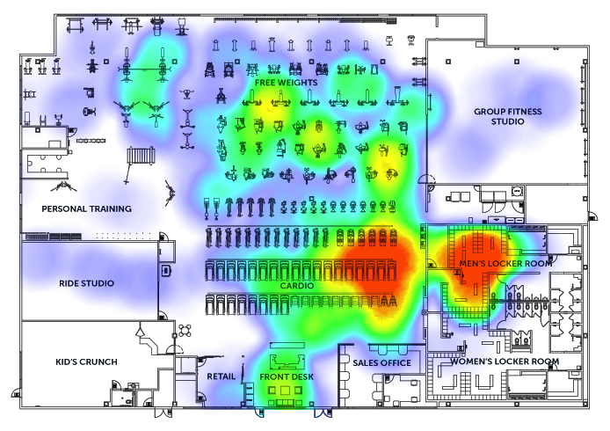
Understand what machines members are using
Wivi and beacons can provide information on what equipment and parts of the facility members are using when they carry a phone or wear a smart watch.
Use information from sensor proximity to create heatmaps for the member and aggregate at club level as well
Infrastructure density directly influences fidelity of heatmap
Notes:
Find out what equipment is being used by which members.

Slide 25
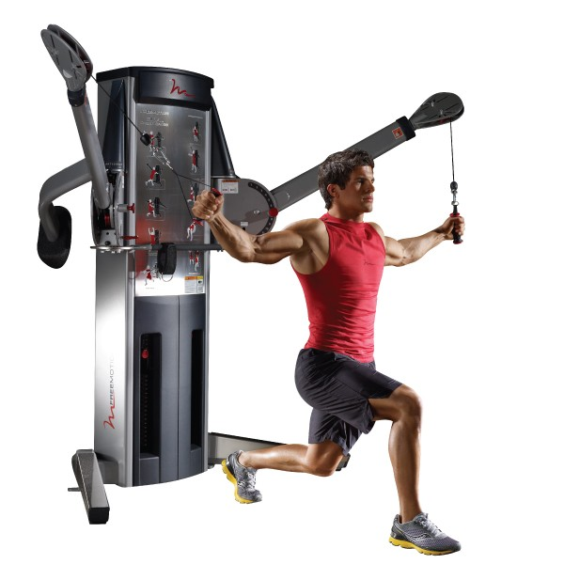
Know what machines the member is using
Ability to track a member’s actual workout and record it, with contextual AI that can count the number of reps and even how much weight was lifted
Create workout regimens tailored to a member’s goals and needs
Suggest new machines to broaden member’s repertoire
Notes:
Placement of beacons on machines (preferable to NFC, which closer proximity) will enable direct 1:1 tracking of which machine is used in a given exercise.
Know the effort expended and # of reps.

Slide 26
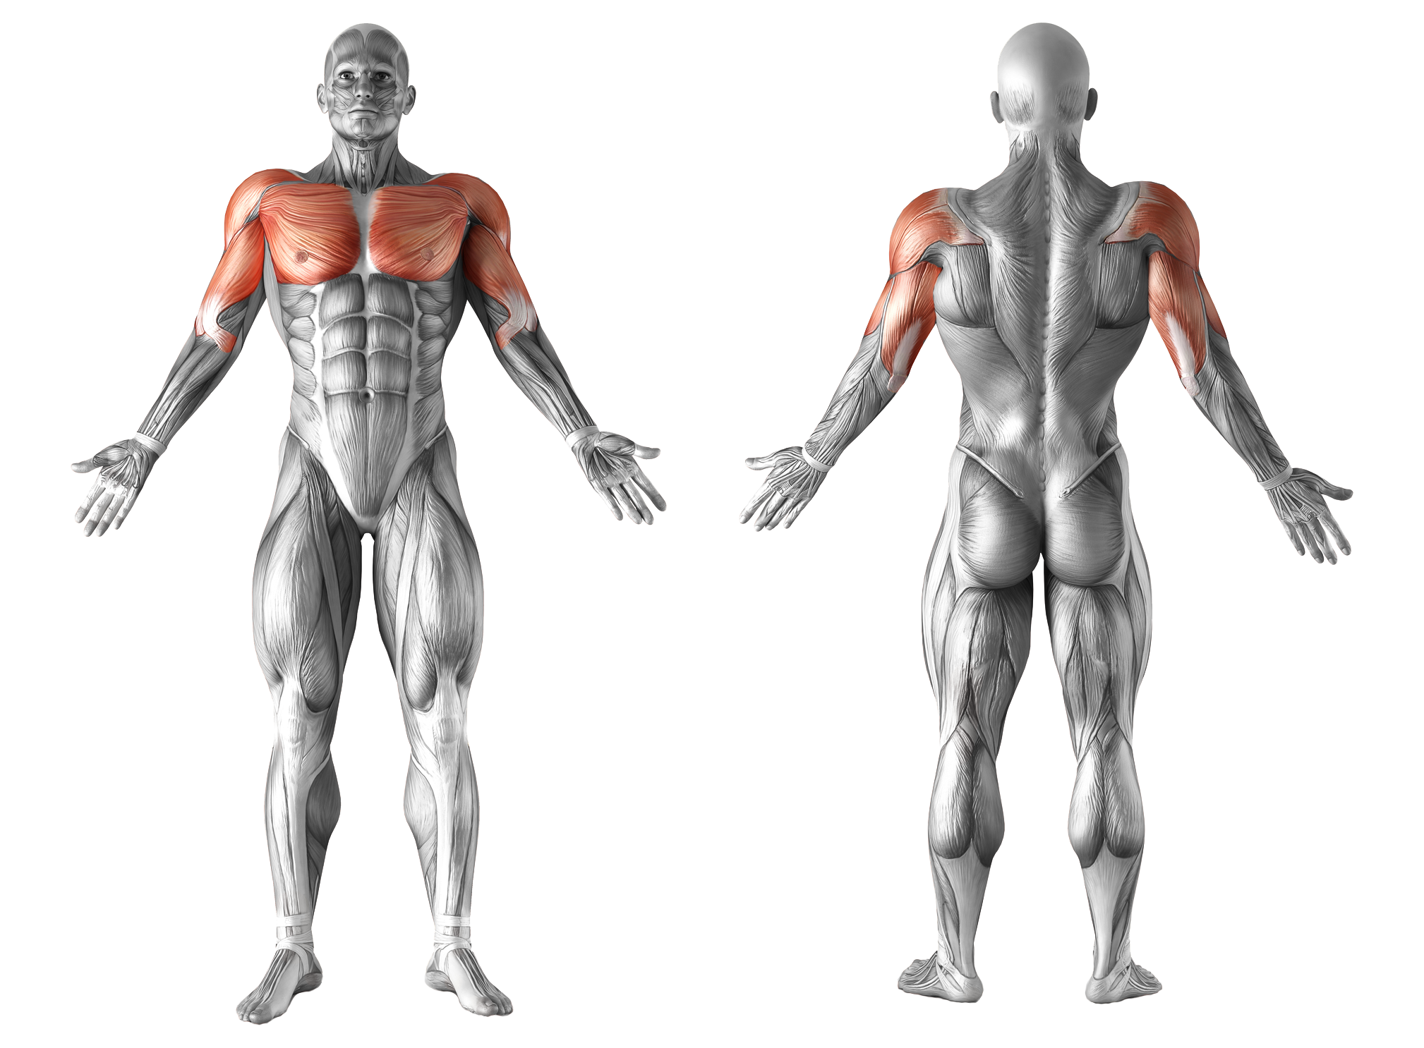
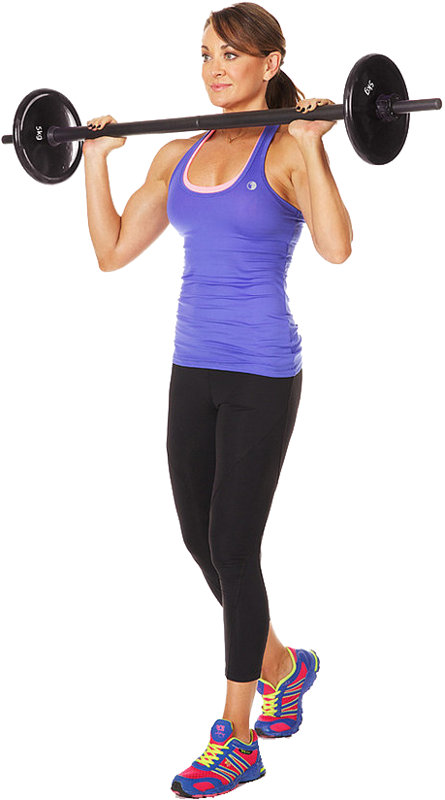
Context is powerful- automatically detect exercises performed
Show on phone if present
Standing Military Press
Notes:
By knowing the machine being used and using a wearable (even a Gear Fit2), tracking muscle group workouts becomes possible.

Slide 27
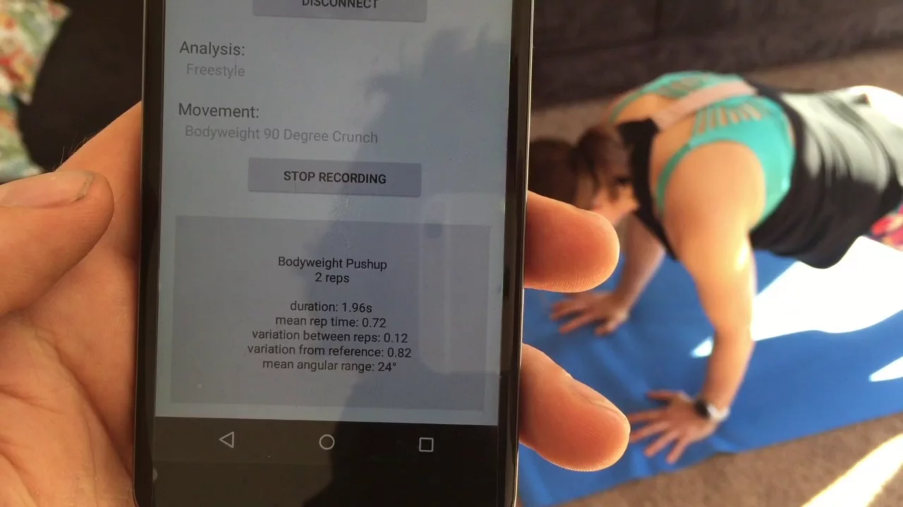
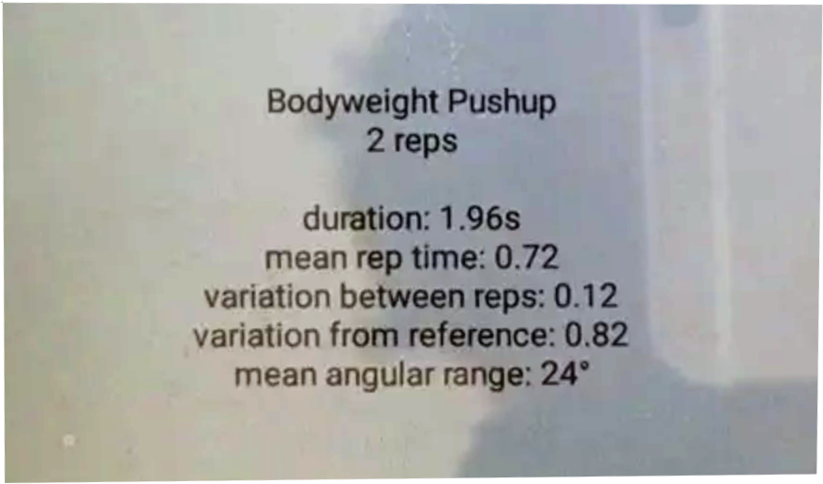
Notes:
To underscore the previous slide, here is an example of Focus Motion’s algorithms using data from a Samsung Gear device, showing a behind-the-scenes data dump.

Slide 28
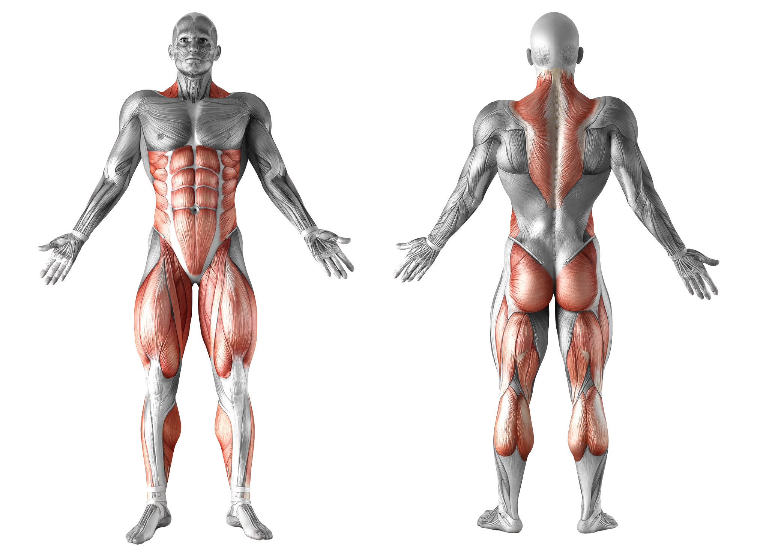
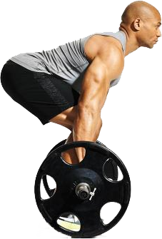
Automatically detect exercise performed
Deadlift
Notes:
Free weight lifting can be determined also, both by using motion detection and other proximity methods to specifically identify how much with simple weights.

Slide 29
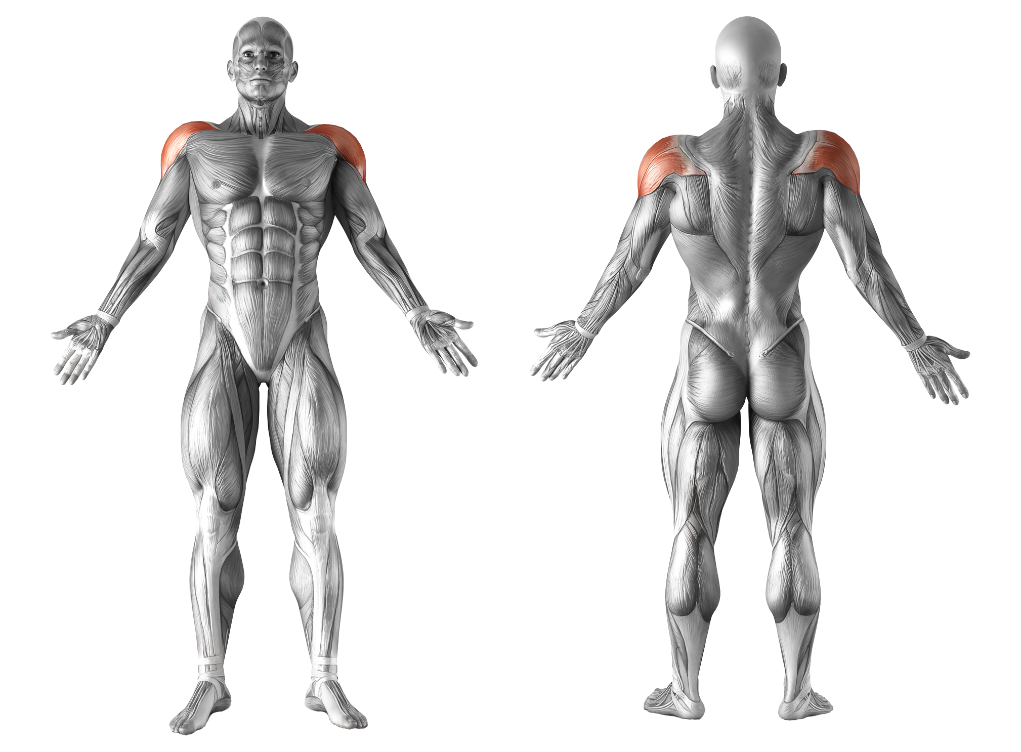
Identify missed muscle groups
Suggest complementary exercises to work out remaining muscles, depending on goals for this workout session.
Missed: Deltoid
Suggest: Dumbbell Bench Press
Chest Day

Slide 30

Summarize a day’s workout
Chest Routine | Reps |  |  | Range of Motion | Negative Efficiency
Incline Press | 15 | 15 | 13 | 3% | 77%
 | 115lb | 135lb | 155lb | 94%
Dumbell Bench Press | 15 | 15 | 15 | 6% | 68%
 | 45lb ea | 50lb ea | 55lb ea | 97%
Incline Dumbell Fly | 15 | 15 | 11 | 7% | 82%
 | 55lb ea | 60lb ea | 70lb ea | 86%
Bench Press | 15 | 15 | 10 | 2% | 83%
 | 145lb | 155lb | 175lb | 98%
Cable Crossover | 15 | 15 | 15 | 9% | 59%
 | 90lb | 110lb | 110lb | 78%
Tip: Slow down on the return portion of each rep to improve this score.
Chest Day
5-week average
Notes:
Show workout details and efficiency of workout, plus recent progress
Show range of motion and total form efficiency, and suggest improvements and tips.

Slide 31
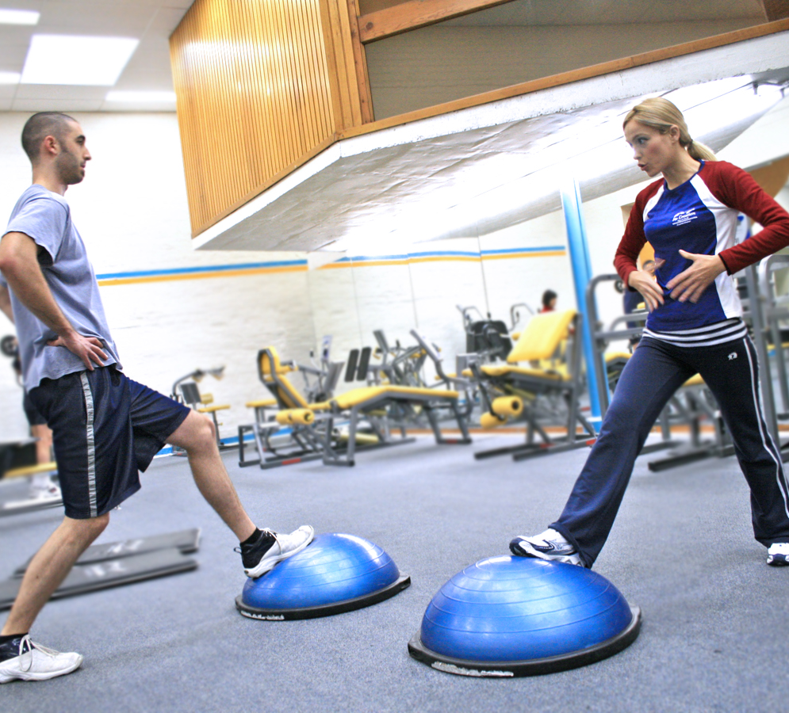
Personal Trainers
When you have context-enabled app, physical trainers can be alerted when member arrives
Trainer can see all member activity and adjust the workout
With a smart wearable, all trainer exercises can be automatically recorded
Notes:
Presence (phone or wearable) can alert trainer that member is on-site. Wearables can enhance PT sessions.

Slide 32
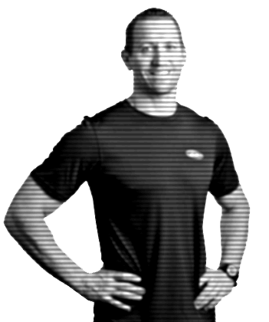
Remote and Virtual Training
Have Trainers remotely train members when off site or offer as an extension to the community and charge for it
Have completely virtual training regimens (based on goal setting) with no trainer oversight
Notes:
Make use of Trainer’s unscheduled time with remote assist training, and add virtual training with pre-planned routines which can optionally be customized to the individual members.

Slide 33
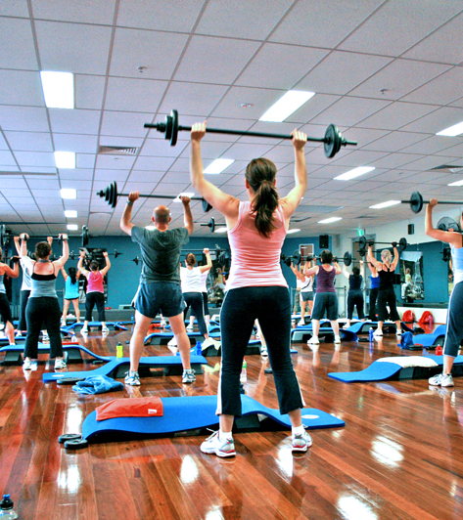
Group Fitness
Record member’s attendance automatically in a group fitness class by presence and record intensity of workout and store in club records an in device health repository.
Group Fitness |  |  | HR Max | HR Avg | Intensitiy
Kickboxing | Jun 23 | 48min | 158 | 137 | 88%
Notes:
Automatically record class activity and effort to the member’s on-device health repository, plus gym master records.

Slide 34
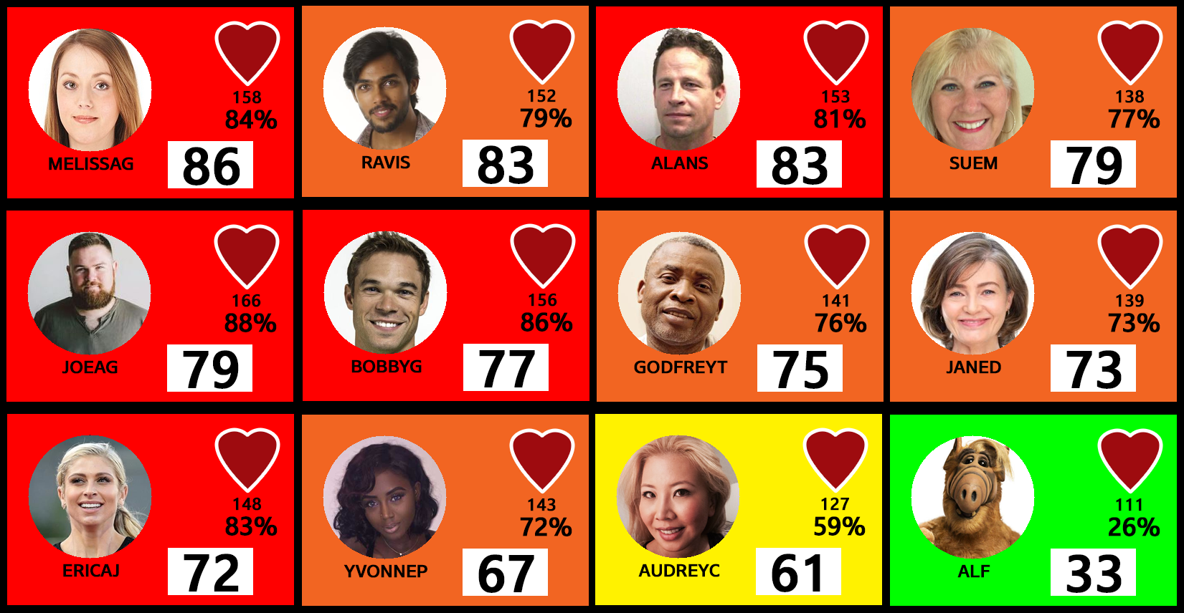
Group Fitness Leaderboard
Notes:
Leaderboards create friendly competition.
These exist now with some standalone solutions, but are not necessarily integrated into a larger, cohesive system.
Wearables can interact directly with visual displays (signage) in the room.

Slide 35
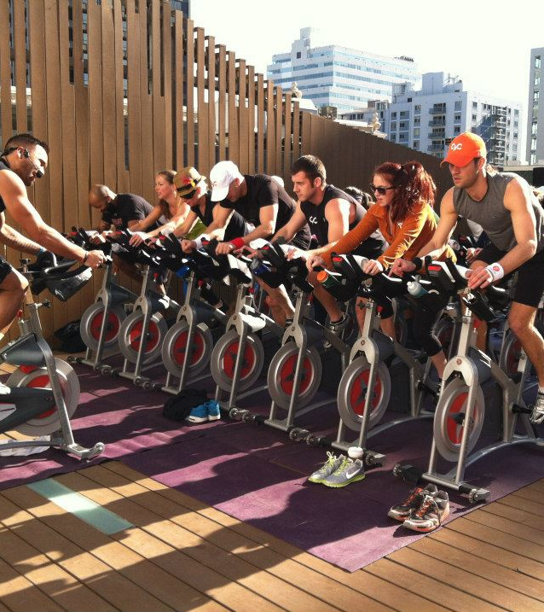
Yield Management
Know how many members attended a class for accurate accounting purposes
Class | Instructor | Attendance
Cardio Jam | Jana | 29
Cycle Zone | Carlos | 18
Kickbox Cardio | Jana | 22
Latin Cardio | Yvette | 20
SilverSneakers | Margot | 18
Step Sculpt | Jenny | 26
Total Body Conditioning | Marcus | 12

Slide 36

Member Rewards
Encourage members to be more active in the club.
Encourage activities outside the club.
Incentivize members to adopt patterns that are beneficial to them and to the club
Positive behavior changes can be rewarded
(happy member = continuing member)
Engaging members more helps reduce churn, thereby reducing acquisition costs
Notes:
Now that you have begun to collect all this data, how do you use it?

Slide 37
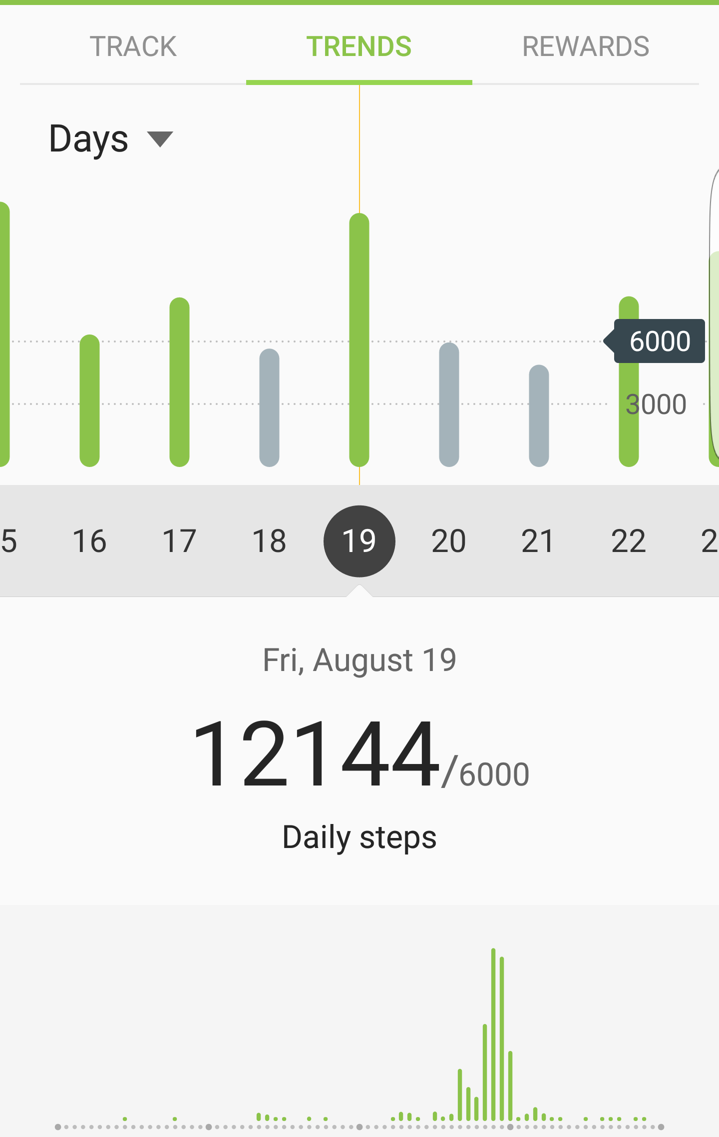
Goal Stretching
Encourage increased external activity by setting, encouraging and then stretching goals as they are met.
This can apply both inside and outside the club
Notes:
Goal setting and setting new goals is important, especially early on when members want to see results more quickly.
Goals for consistency are suitable once a member has achieved their goals and move to maintenance mode.

Slide 38
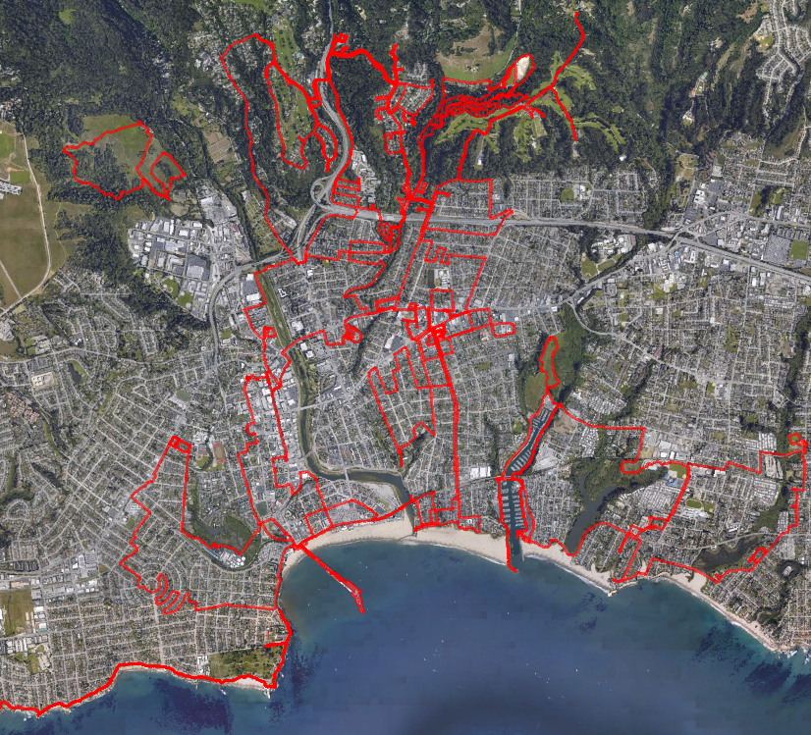
Paint the town red
Encourage external exercises from walking to running to cycling, based on member preferences.
Encourage variety and cumulatively track and map
Add a social element by connecting like-minded members
Notes:
Suggestions can be crowd-sourced as well and ranked by local popularity.

Slide 39
Broaden member engagement in club
Members that use only a few pieces of equipment or only 1 or 2 areas of the club have a higher likelihood of dropping out.
Providing bonus points- a “collect them all” strategy, can work to motivate members to learn how to use more pieces of equipment.
Offer help videos for new machines to encourage use
Notes:
Coming back to the heatmap, you can use this information to broaden

Slide 40

Balance facility and equipment usage
Members come during peak periods and crowd the equipment, making the experience less productive for everyone.
Automatic check-in (using phone and/or wearable) can record when a member comes and goes and how long they stay.
Reward points for off-hour visits would incentivize a portion of membership and reduce rush hour equipment overutilization
Notes:
Load balancing.
One of the complaints was “overcrowded gym”

Slide 41
Redeem and Pay
NFC in watches and phones can be used to redeem points and pay for purchases
Samsung Pay accommodates gift cards as well
Phones and Gear S3 supports Magnetic Secure Transmission- pay on legacy POS terminals with same security as NFC payments (and leave the wallet at home)

Slide 42

Member Aggregate Data

Slide 43
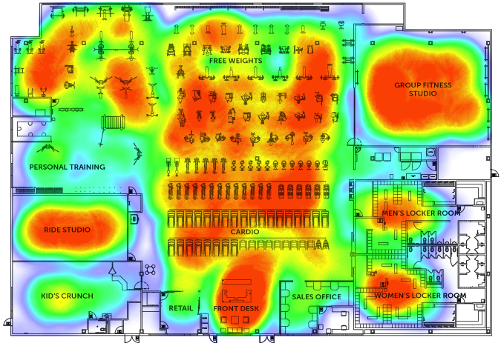
Equipment Utilization at the Club Level
Understand what equipment is being use the most and the least, those you need to buy more of and those you can replace.
Aggregated information from across the member base provides detailed usage patterns
Identify layout issues and optimize equipment placement
Help identify most-used equipment
Notes:
Aggregate data Addressing club-level benefits
Grocery store-milk model

Slide 44
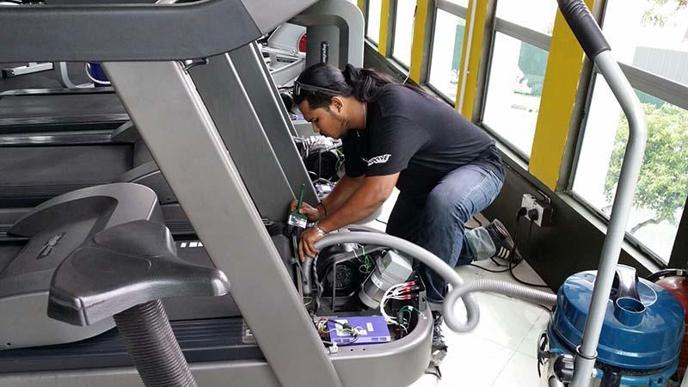
Equipment Maintenance
When equipment usage can be directly identified, it is easy to spot over-usage (perhaps due to location) of equipment via a dashboard instead of accessing machines one at a time to check usage logs
Identify when to rotate equipment
Identify when preventative maintenance is needed more quickly.
Notes:
See all machines at a glance in terms of utilization

Slide 45
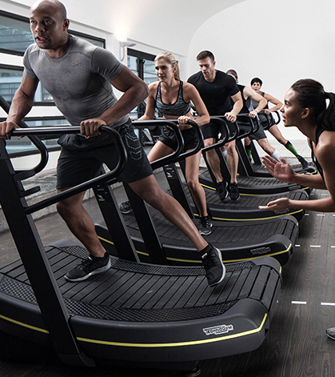
Equipment Promotion
Promote usage of new machines through app on phone and proximity by wearable.
Use of machine can be automatically detected and points awarded.
Offer instructional videos for first time users

Slide 46
Areas of ROI for the Club
Incremental Revenue
Margin Improvement
Member Value
Offer new services
Improve facility use
Accurate accounting
Proactive management
Low cost, value added services
Member rewards for behavior that benefits facility
Better member engagement = happier members
Upsell club offerings
New partnership opportunities
Notes:
We believe by adopting modest technology, you can have additional data for your members, and you’ll be able to start looking at ways to increase overall revenue of the club

Slide 47
Where this all leads
When you have happier members, you have reduced dropouts, improved efficiencies, and have possibilities of more upsells and digital add-ons
You also now have a trove of analytics- member data, that individually can be used to incentivize members and in aggregate can be used to more efficiently manage the club and plan for the future.

Slide 48

Member Analytics Today
Basic Personal Data
Membership duration
Check-ins, Timestamps
Training & Special Classes
Notes:
Member data is very basic today

Slide 49
Possible member analytics- internal
Basic Personal Data
Membership duration
Check-ins, Timestamps, Duration
Training & Special Class registration
Heat map of club visits
Equipment used and classes attended
Workout intensity
Notes:
Data can be much more detailed using member phones, and wearables will add even more data.

Slide 50
Possible member analytics- external
External basic activity & inactivity
External exercise
Sleep data
Food data, if tracked
Stress data

Slide 51
Modularity
Analytics | Member |  |  | Club
 | Phone | Watch |  | Geofence only | WiFi only | Beacons | NFC
Habits & Schedule
Virtual Tracking | some | better
Duration
Member Usage Patterns | some | better |  |  | some | better
Member Exercises |  |  |  |  | some | better
Physical Training |  |  |  |  | some | better
Group Tracking
Yield Management
Facility Usage |  |  |  |  | some | better
Equipment Utilization
Data Analytics | some | better |  |  | some | better
Notes:
This is not an all-or-nothing solution. It’s modular and delivers benefits with even a few components. Wearables are key to the deeper experiences, though.

Slide 52
Data & Analytics
When you have data, you can make better decisions
You can experiment
You can try out new ideas even on small subsets of members to relative measure success- A/B Testing

Slide 53

Corporate Wellness
Samsung is beta testing its corporate wellness program using its own Gear devices
Integrates with Virgin Pulse
Notes:
That wraps up the main, Fitness 360 presentation. I’d like to cover another, related topic before we head into the roundtable discussion.
Samsung is getting involved in Corporate Wellness.

Slide 54
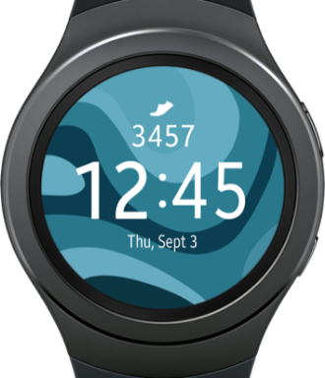


Smart Wearables Poised To Transform Wellness Market
Emerging Enterprise Issues
Expected Wearable Tech Impact
50% Wearables Sales Expected From B2B
Wearable US TAM($B)
po
$700B
spend by employers on Employee health claims per year
63%
Insurers believe wearables will transform industry
($100B saving)
$17.7
CAGR
35%
143%
80%
Wearable to be
“Wrist-worn” form factor
By 2019
Consumer
B2B
-2%
Annual 2016
Productivity decline
($450B per year lost
in productivity)
+8.5%
Employers expect Work productivity increase per year
$6.5
$2.1
2014
2016
2019
Source: PWC, AHPC, Bureau of Labor Statistics, Accenture, Emarketeer , Compass Intelligence 2016, and IDC 2015
Notes:
We see these as business devices, too.

Slide 55
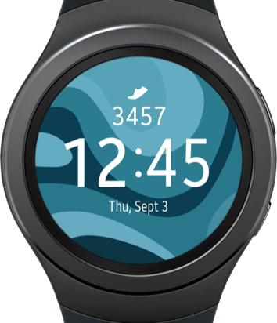









GearHub Better Enables Wellness Platforms
Access to 15M+ Employees
through Wellness Platform partners (VARs)
Improving the Wearable Experience
B2c
experience
B2b
experience
1
Consumer-grade watches don’t necessarily directly communicate real-time via cloud services
Dependence on Phone for some models
Manual setup by consumer results in lower adherence
15M+
Employees
Gear SensorHub
2
3
Pulls advanced data from Gear S2/S3 & Fit2 without a mobile app
Stores in “GearHub” cloud and provides API links to partners
Allows partners to sell Gear S2/S3 and Fit2 as a linked wellness wearable
<20% engagement
when bought by consumer
>60%
engagement
when engaged in a
work wellness program
Source: Allied Market Research

Slide 56
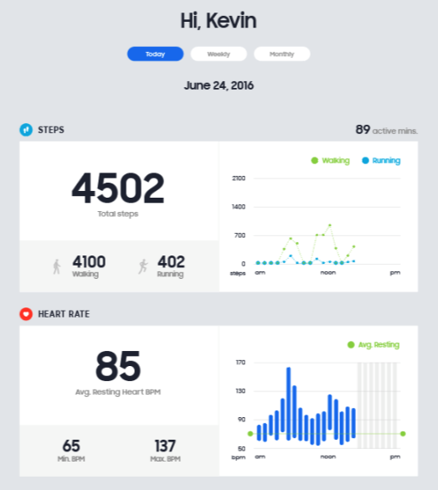

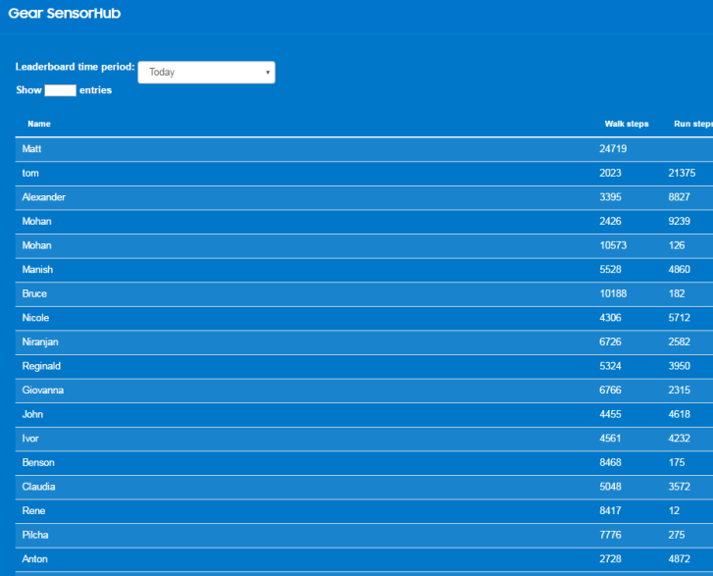

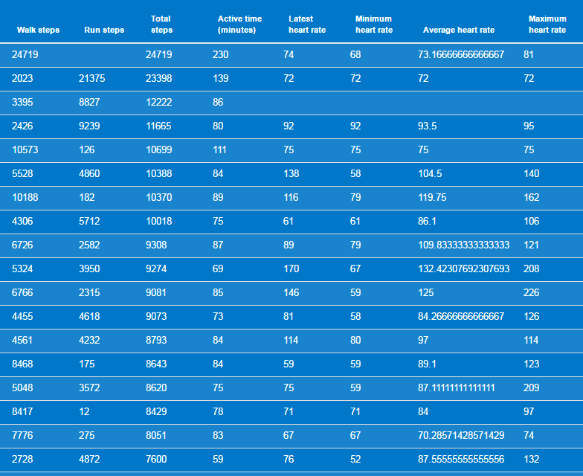
GearHUB Admin and Individual Dashboard

Slide 57

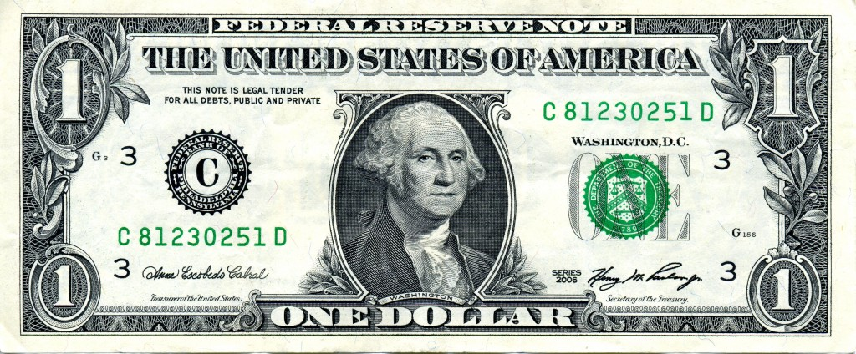

Wellness Program Statistics
Additional Statistics³:
26% reduction in medical costs
78% of Americans describe job as “stressful”
70% fewer sick days taken
Only 28% of companies with program give incentives⁴
51% of employers with >50 people offer a wellness program ⁵
42% of those offer club discounts ⁵
ROI= up to 3x¹
Real time (e.g., from GearHUB) allow fast feedback to member and better predictive modeling by company²
Forbes
www.cio.com
Office Vibe
Rival Health
Department of Labor

Slide 58

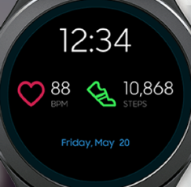



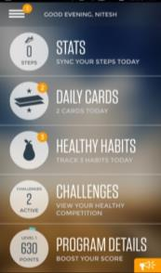
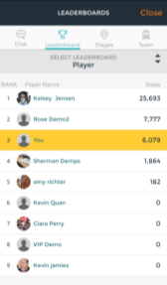

Corporate Wellness For Employees (beta)
PERSONALIZE
GAMIFY
INCENTIVIZE
500 employees
At 3 locations
15M
employees though 10 Wellness vendors
Notes:
Beta is currently taking place internally. Market is 15m and growing that partcipate through a VAR
Sleep and HIPAA compliance is coming by 1Q17

Slide 59
All of this tracking is enabled by use of phone and/or smart wearable devices and modest infrastructure investments.
Phones will get you some data, smart wearable devices will get you much more.
Notes:
That gives a bit of a view of what we are doing in Corporate Wellness.
Now, we will transition to the roundtable discussion…
To summarize, the connected gym benefits all members, whether independently a member of your club, or a member through a corporate wellness program.

Slide 60




Cycle
Motivate
Engage
Reward
Influence
Data & Analytics
Notes:
By using smart components in mobile phone and wearable apps, you can use them to …
… gather data and analytics to drive your club
And interact with your members in all, new ways.

Slide 61



Partners helping build this system
We are working with multiple companies, each bringing their own technology and platforms together, to work cohesively, and we’ll be having them up on the stage in a few minutes.
Notes:
Samsung (and others) provide the devices, and our partners provide the solutions. We then work with the industry to tailor the solutions to their needs.

Slide 62

Modular Components of Solution
Input / capture
Motion capture
Wearables
Phones
Input / capture
Beacons
WiFi
Geo-fences
NFC tags
POS
Video capture
Output / experiences
Tablets / POS
Signage/Displays
VR
Online
Output / experiences
Phones
Wearables
Video
Augmented Reality
App/Online
Club App
Notes:
Underscore modularity of the system, that it’s not an all-or-nothing proposition. Even small investments will generate data and hence return.

Slide 63




Panelists
Jeffrey Cooper
Samsung
Erik Bjontegard
CEO, Total Communicator
Solutions
Cavan Canavan
CEO, Focus Motion
Lee Silverstone
Cofounder, Gymtrack

