Slide 1
Customer Engagement Using Technology
Gap Innovation Summit
Jeffrey Cooper
Sr Mgr Business Development
Mt View, CA
Notes:
Role of technology intersection with fitness, making it personal

Slide 2
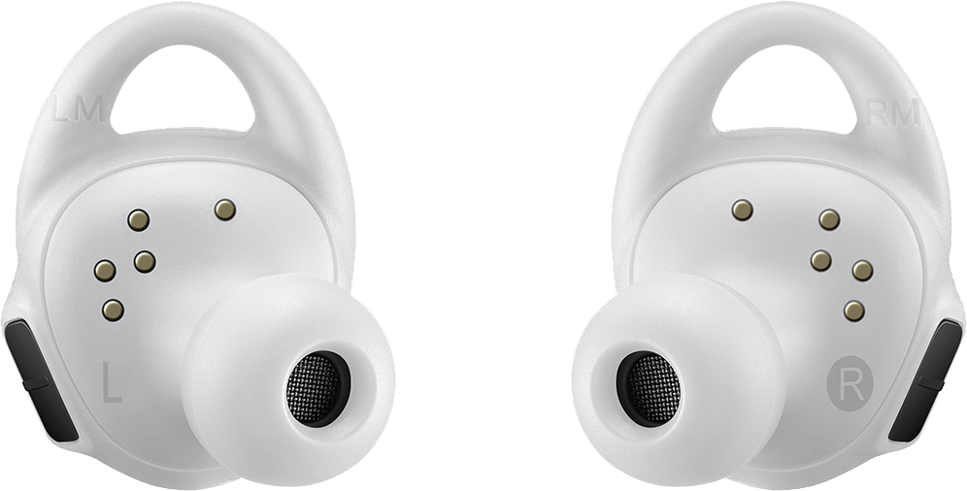
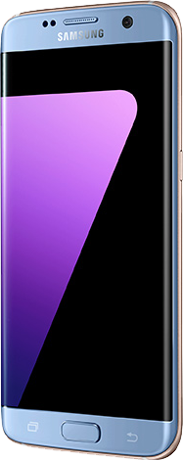
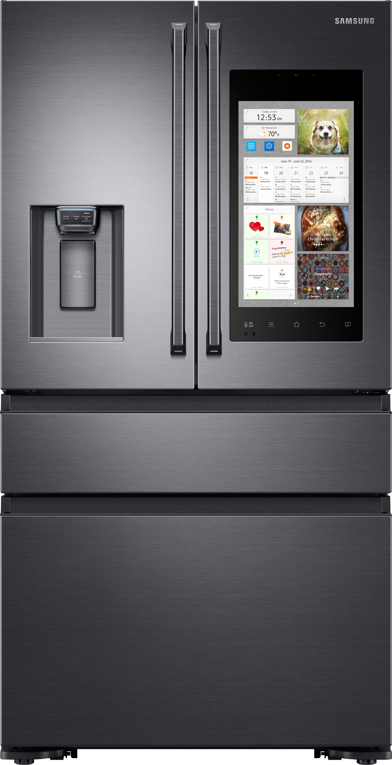
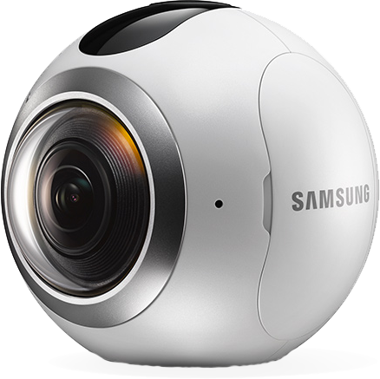
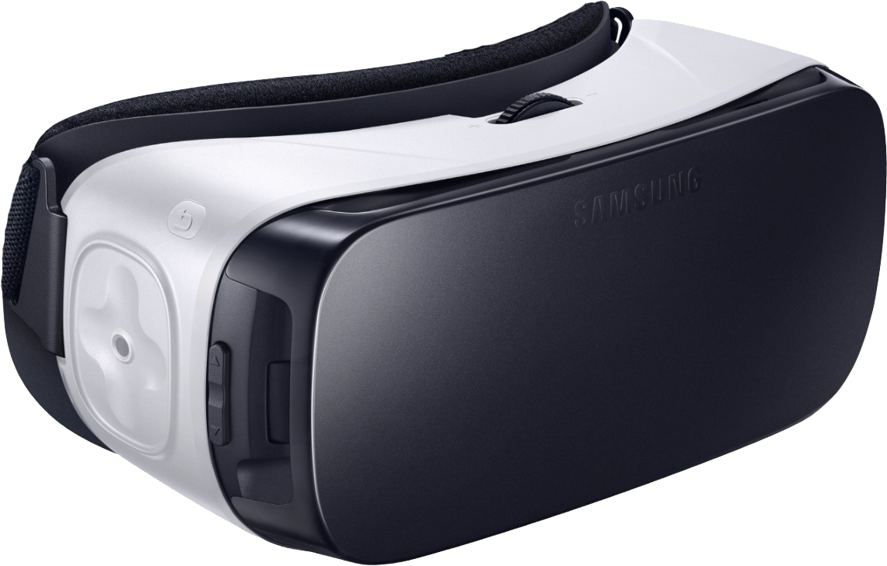
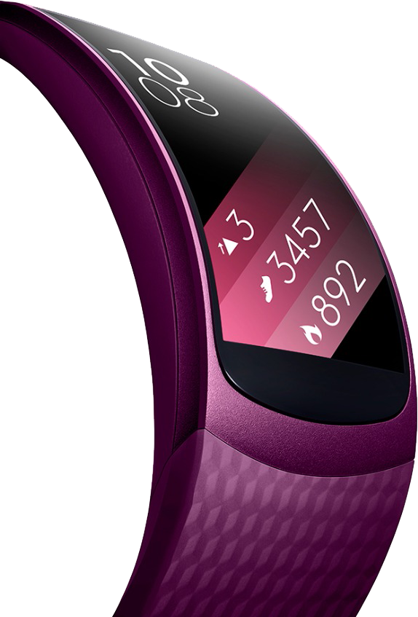

Slide 3
Philosophy for Innovation
Solutions need to work seamlessly, interacting across as many devices as sensible- wearables, phones, TVs and digital signage
Solutions should be “no fuss” solutions- they are as touchless as possible and “just work”
Privacy and Security or personal data must be respected and secured.
Customers
Consumers, direct or indirect
Companies & their employees
Notes:
Where I am situation in Samsung and what I work on
My technological and application philosophy
Passion for fitness and health

Slide 4
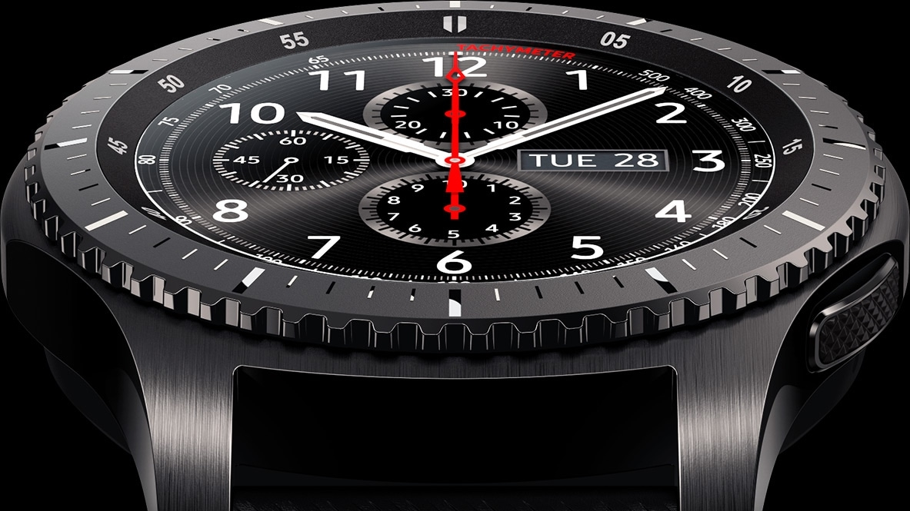
Fitness Club Example

Slide 5
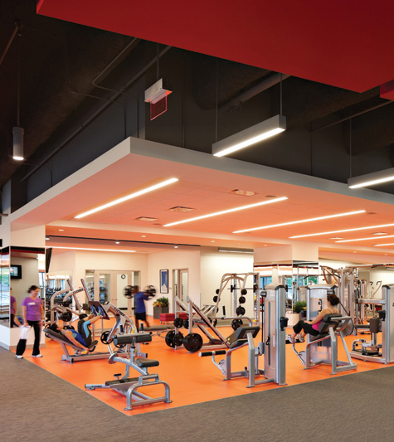
Fitness Clubs
Fitness clubs have a retention problem
35-45% of their members quit each year*
Acquisition of new members costs >5x more than retention**
In the digital age of fitness, gyms are in the dark ages
*IHRSA statistics
**Statista

Slide 6
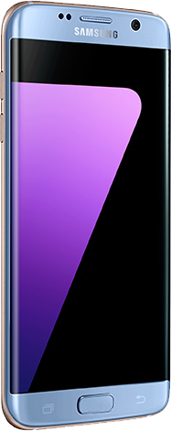
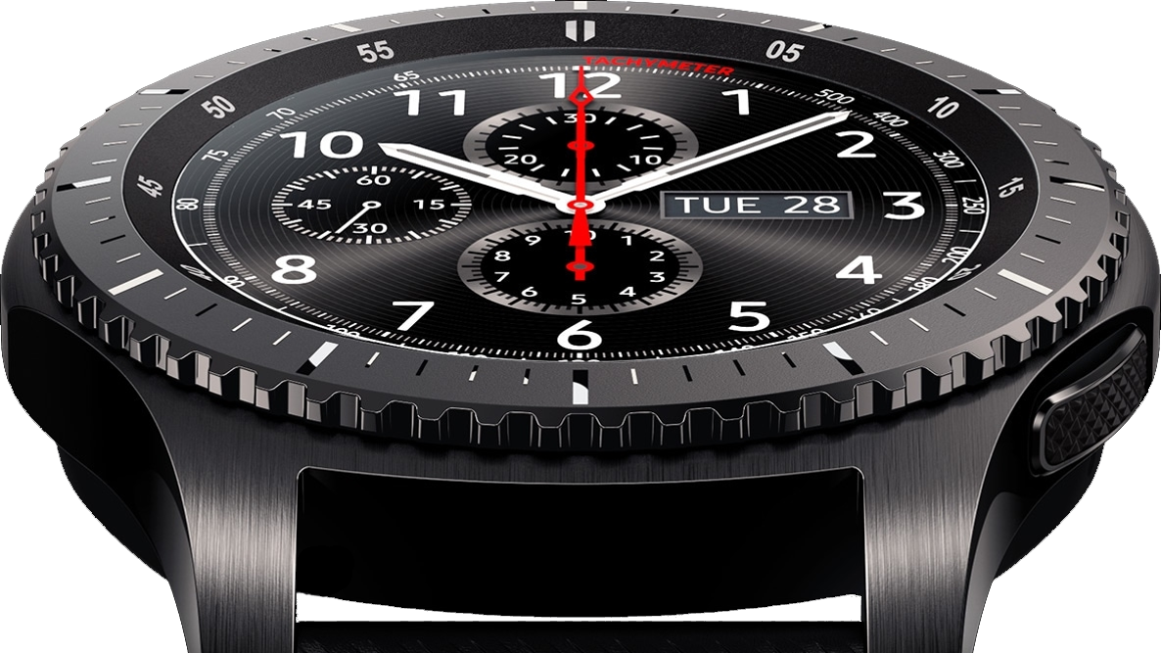
The Solution
Using a combination of personal devices, beacons and signage creates a system that generates rich member learning and insights to allow useful interactions with their members.

Slide 7
Areas of ROI for the Club
Incremental Revenue
Margin Improvement
Member Value
Offer new services
Improve facility use & efficiency
Accurate accounting for classes
Proactive management
Low cost, value added services
Member rewards for behavior that benefits facility
Better member engagement = happier members
Upsell club offerings
New partnership opportunities
Notes:
What I want to talk about today is how to use technology and the data it provides to improve revenue.
By having additional data on your members, you’ll be able to start looking at ways to increase overall revenue of the club

Slide 8
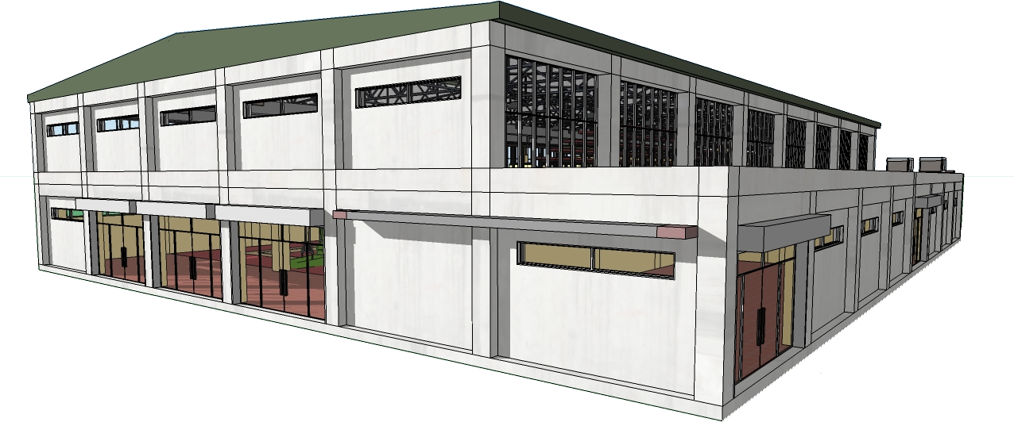
Two Perspectives
The Club
The Member

Slide 9
The Club
Optimize Relationship with existing members
Loyalty extensions
Operational efficiency

Slide 10
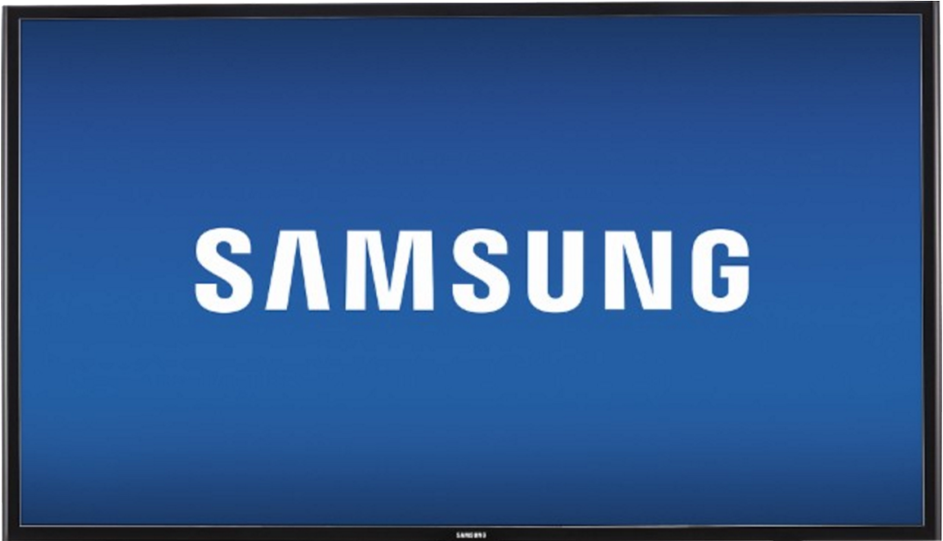
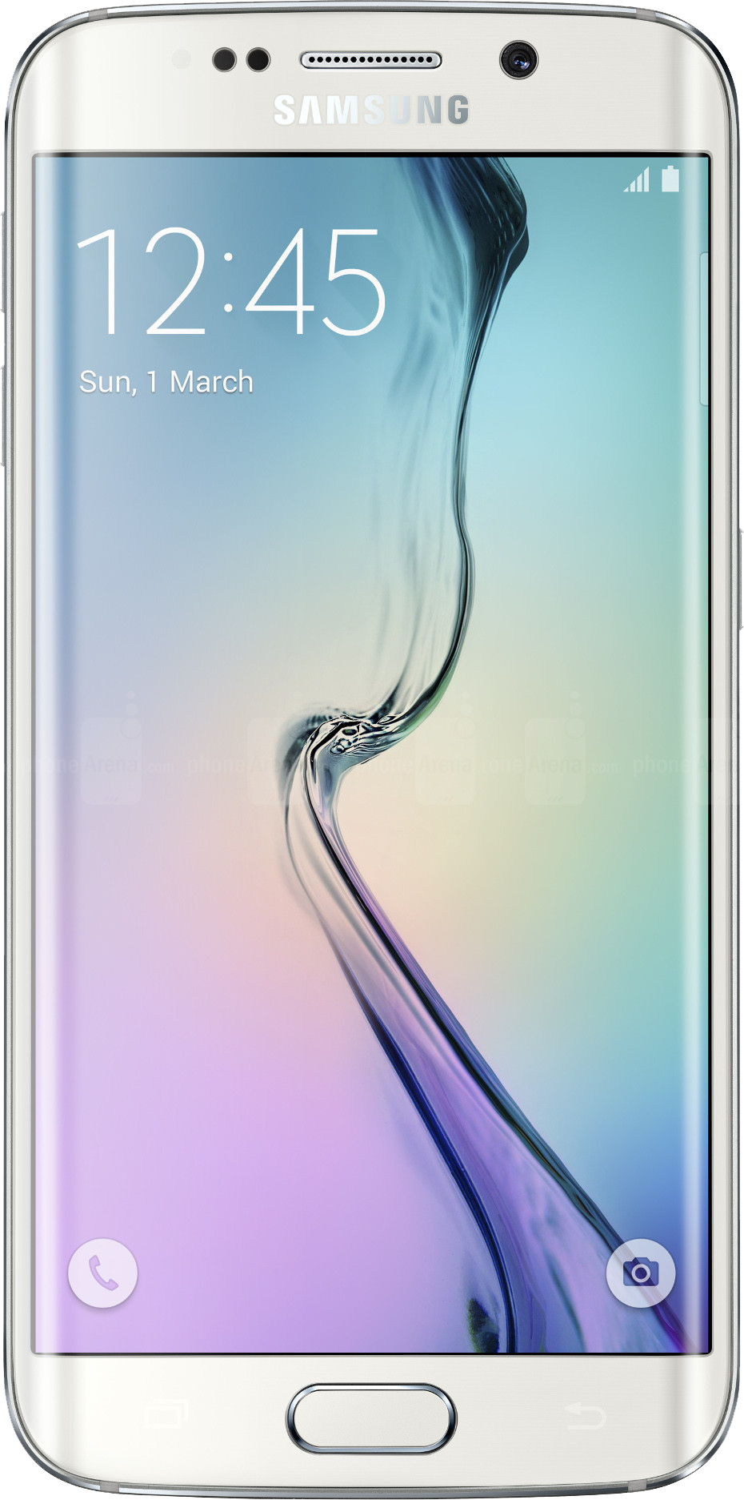
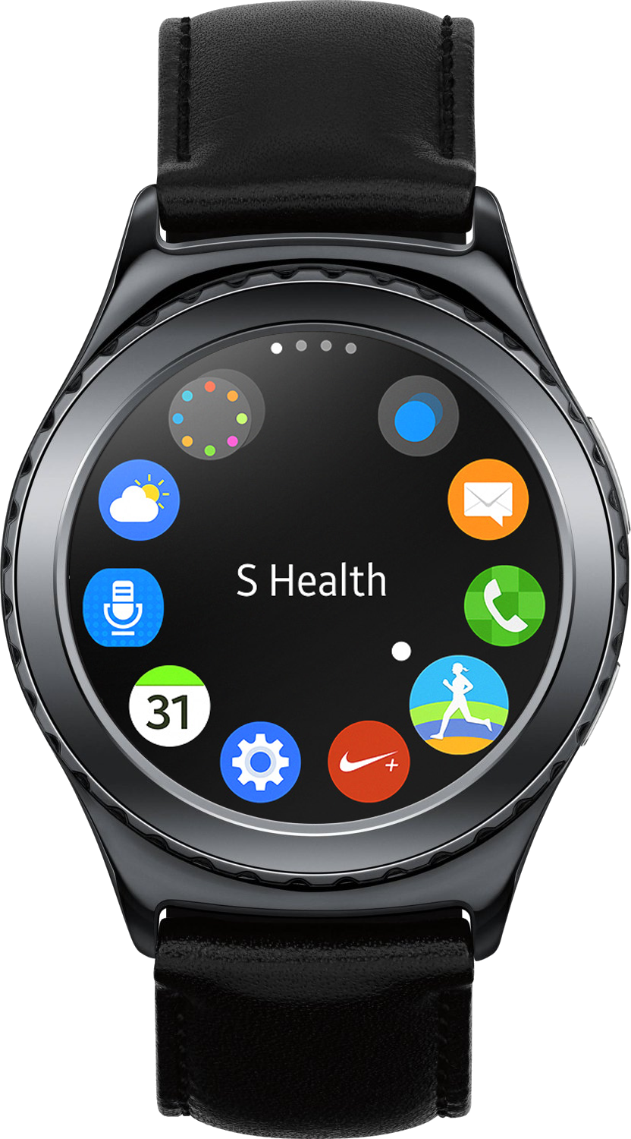
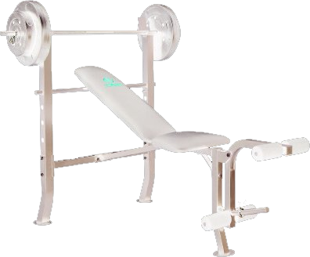
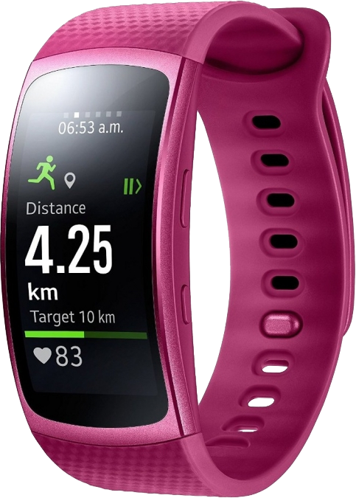
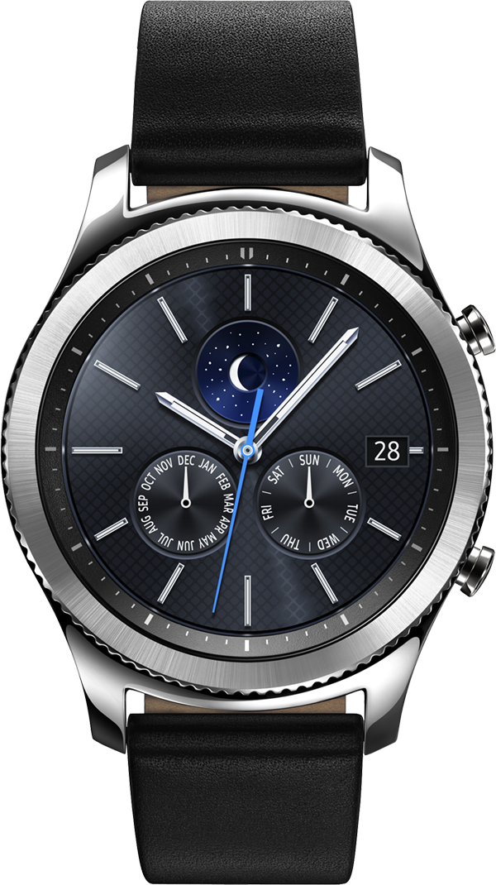
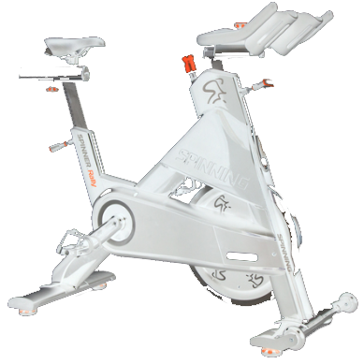
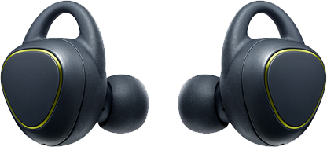
Snapshot of the present
Personal Health Tracking and club-based workouts are disconnected- they exist in separate universes.
Notes:
Today we our smartphones and to some extent, smart watches, that track our moves.
Clubs are full of largely disconnected equipment (even if the console is connected to the Internet, most machines are not connected to the user). Club may or may not have TVs or digital signage.
Clubs have not kept pace (for various and many good reasons)

Slide 11
Present State
Check-in is manual
Members have no interaction with the club when they check in
Club has no data on the member once they have checked in
Once checked in, members are on their own and the club has only scattered information on usage statistics.
Member experience is isolated
Notes:
Members don’t interact with the club or the equipment
Workout data is lost

Slide 12
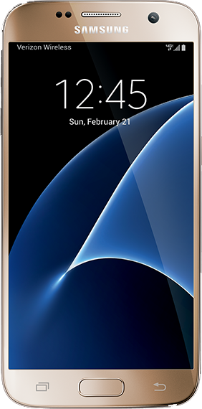
Start Simple
Nearly everyone has a smartphone, which is the logical starting point.
Adding a simple contextual element unlocks a number of opportunities to more richly interact with your member, regardless of phone type.
Context is simply combining Who, What, Where and When together to allow a more personalized experience.
Notes:
Context is the theme of this presentation. Mobile and wearable value is limited without it.

Slide 13
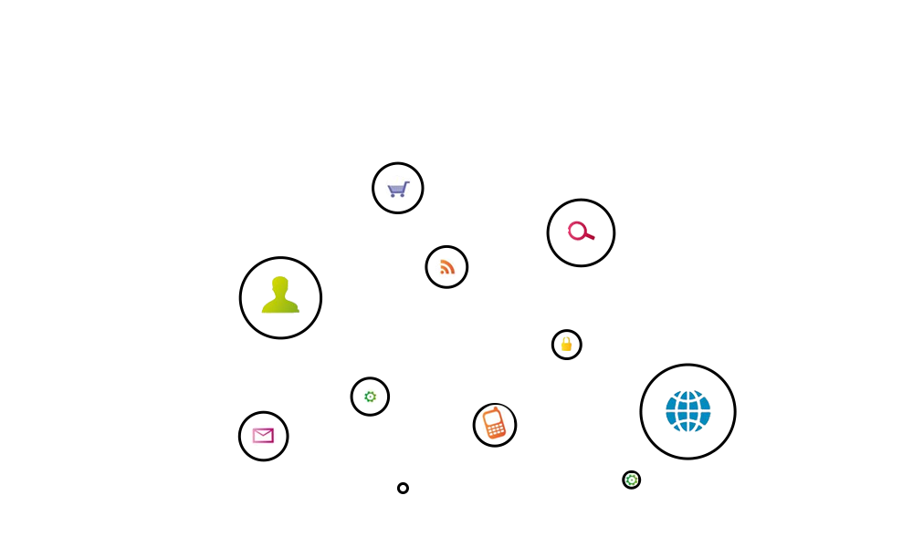
Context and communication connect the two worlds
Context-enabled applications
Notes:
It is possible to use today’s technology with existing equipment, taking context and fusing it with the expertise in the industry.
The simple addition of a few beacons and tying them into your backend system will enable a lot of new functionality.

Slide 14
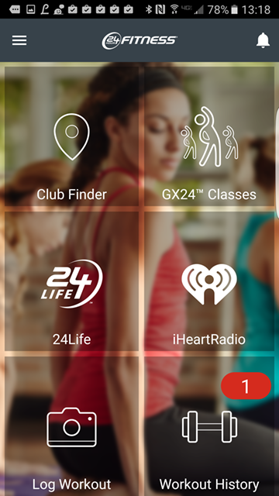
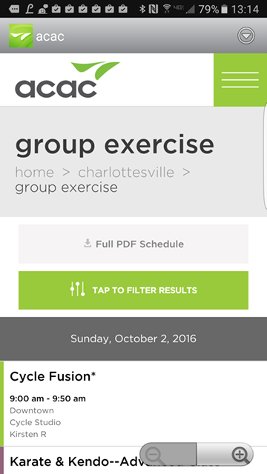
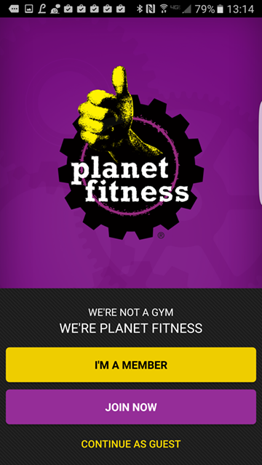
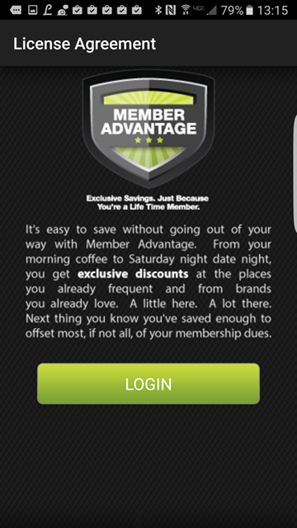
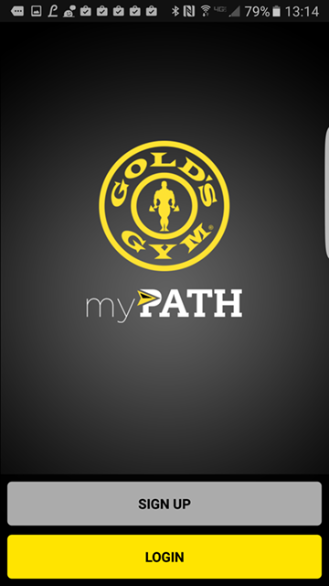
Start with your mobile app
Adding a small, contextual element to your mobile app plus a beacon near the entrance opens the door to personalization
Notes:
Context features are enabled through the app, and can be incentivized through Member Rewards (more on that later).

Slide 15
Frictionless Check-in
Automatically triggered
Expired: Update Credit Card
Placing a single beacon by the entrance enables a richer member interaction, starting with automated check-in
Notes:
Check in just by walking in.
Alert front desk to status such as lapsed credit card.
Greet them by name.
Recognize achievements (years of membership, activity level, status gains)

Slide 16
Instant Promotion
At check-in, pop up a notice on member’s phone and watch and let them know that a group fitness class is about to start
31% of non-group fitness members would consider taking a group fitness class(Nielson)
Alert member to new equipment or offering
http://www.slideshare.net/Bryankorourke/nielsen-global-consumer-exercise-trends-survey-2014
Notes:
Promote group fitness- members who participate in group fitness classes are typically more loyal.

Slide 17
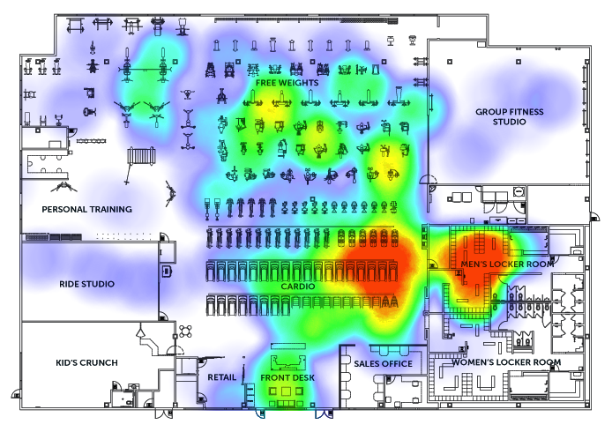
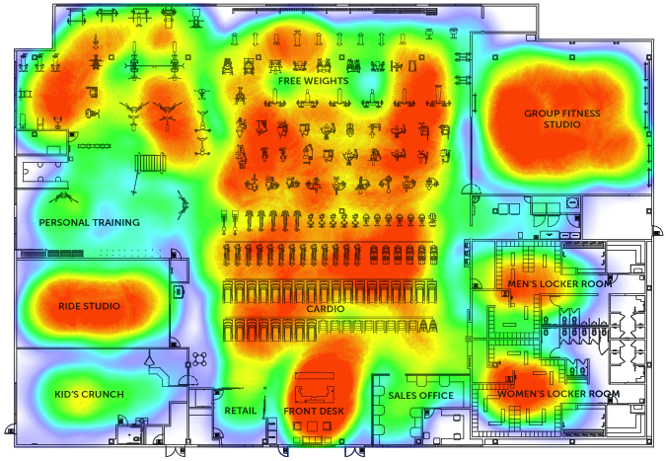
Understand where members are engaging in the facility
Use information from beacon proximity to create heat maps for the member and aggregate at club level as well
Provides data on member’s usage patterns
Optimize facility layout
Infrastructure (beacon) density directly influences fidelity of heatmap
Notes:
Find out what equipment is being used by which members.

Slide 18
Deliver Content on Proximity
Notes:
Near equipment, you can provide VOD

Slide 19
The Member
Switching viewpoints to a member perspective:
Members will benefit from new technology as well
Connect out of club and in club workouts into a complete fitness view
Especially Millennials expect to interact mainly with their phones
Notes:
Let’s switch to the Member perspective. How do you view your members?

Slide 20
Member Rewards
Encourage members to be more active in the club.
Encourage activities outside the club.
Incentivize members to adopt patterns that are beneficial to them and to the club
Positive behavior changes can be rewarded (happy member = continuing member)
Engaging members more helps reduce churn, thereby reducing acquisition costs
Notes:
Now that you have begun to collect all this data, how do you use it?

Slide 21
Broaden member engagement in club
Members that use only a few pieces of equipment or only 1 or 2 areas of the club have a higher likelihood of dropping out.
Providing bonus points- a “collect them all” strategy, can work to motivate members to learn how to use more pieces of equipment.
Offer help videos for new machines to encourage use
Notes:
Coming back to the heatmap, you can use this information to broaden members’ repertoire

Slide 22
Balance facility and equipment usage
Members come during peak periods and crowd the equipment, making the experience less productive for everyone.
Automatic check-in (using phone and/or wearable) can record when a member comes and goes and how long they stay.
Reward points for off-hour visits would incentivize a portion of membership and reduce rush hour equipment overutilization
Notes:
Load balancing.
One of the complaints was “overcrowded gym”

Slide 23
Analytics Data- Before & After
Before
Level 2
Level 3
Level 4
Basic Personal Data
Class Attendance Totals
Club Utilization Heatmaps
Advanced Workout Intensity
Membership Duration
External Activity & Exercise
Member Heatmaps
Detailed Workout History
Check-in Time Stamp
Sleep Data
Equipment Used
Advanced User Fitness Preferences
Class & Training Registration
Stress Data
Better User Fitness Preferences
Nutrition, if tracked
Level 1
Length of visit
Basic Workout Intensity
User Fitness Preferences

Slide 24
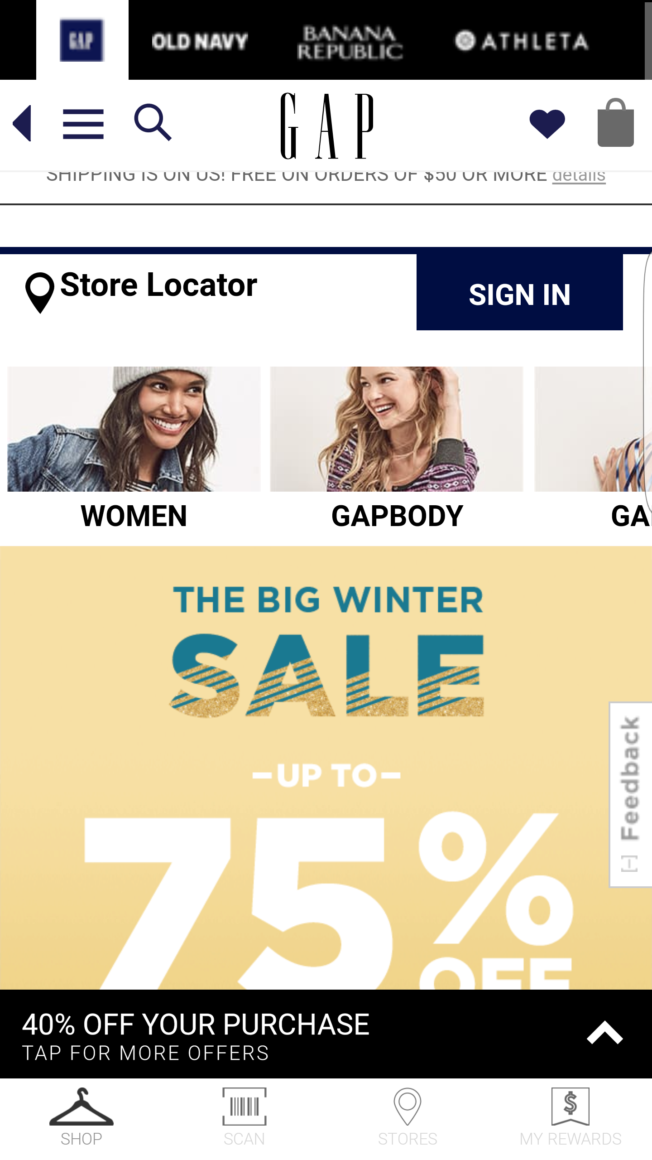
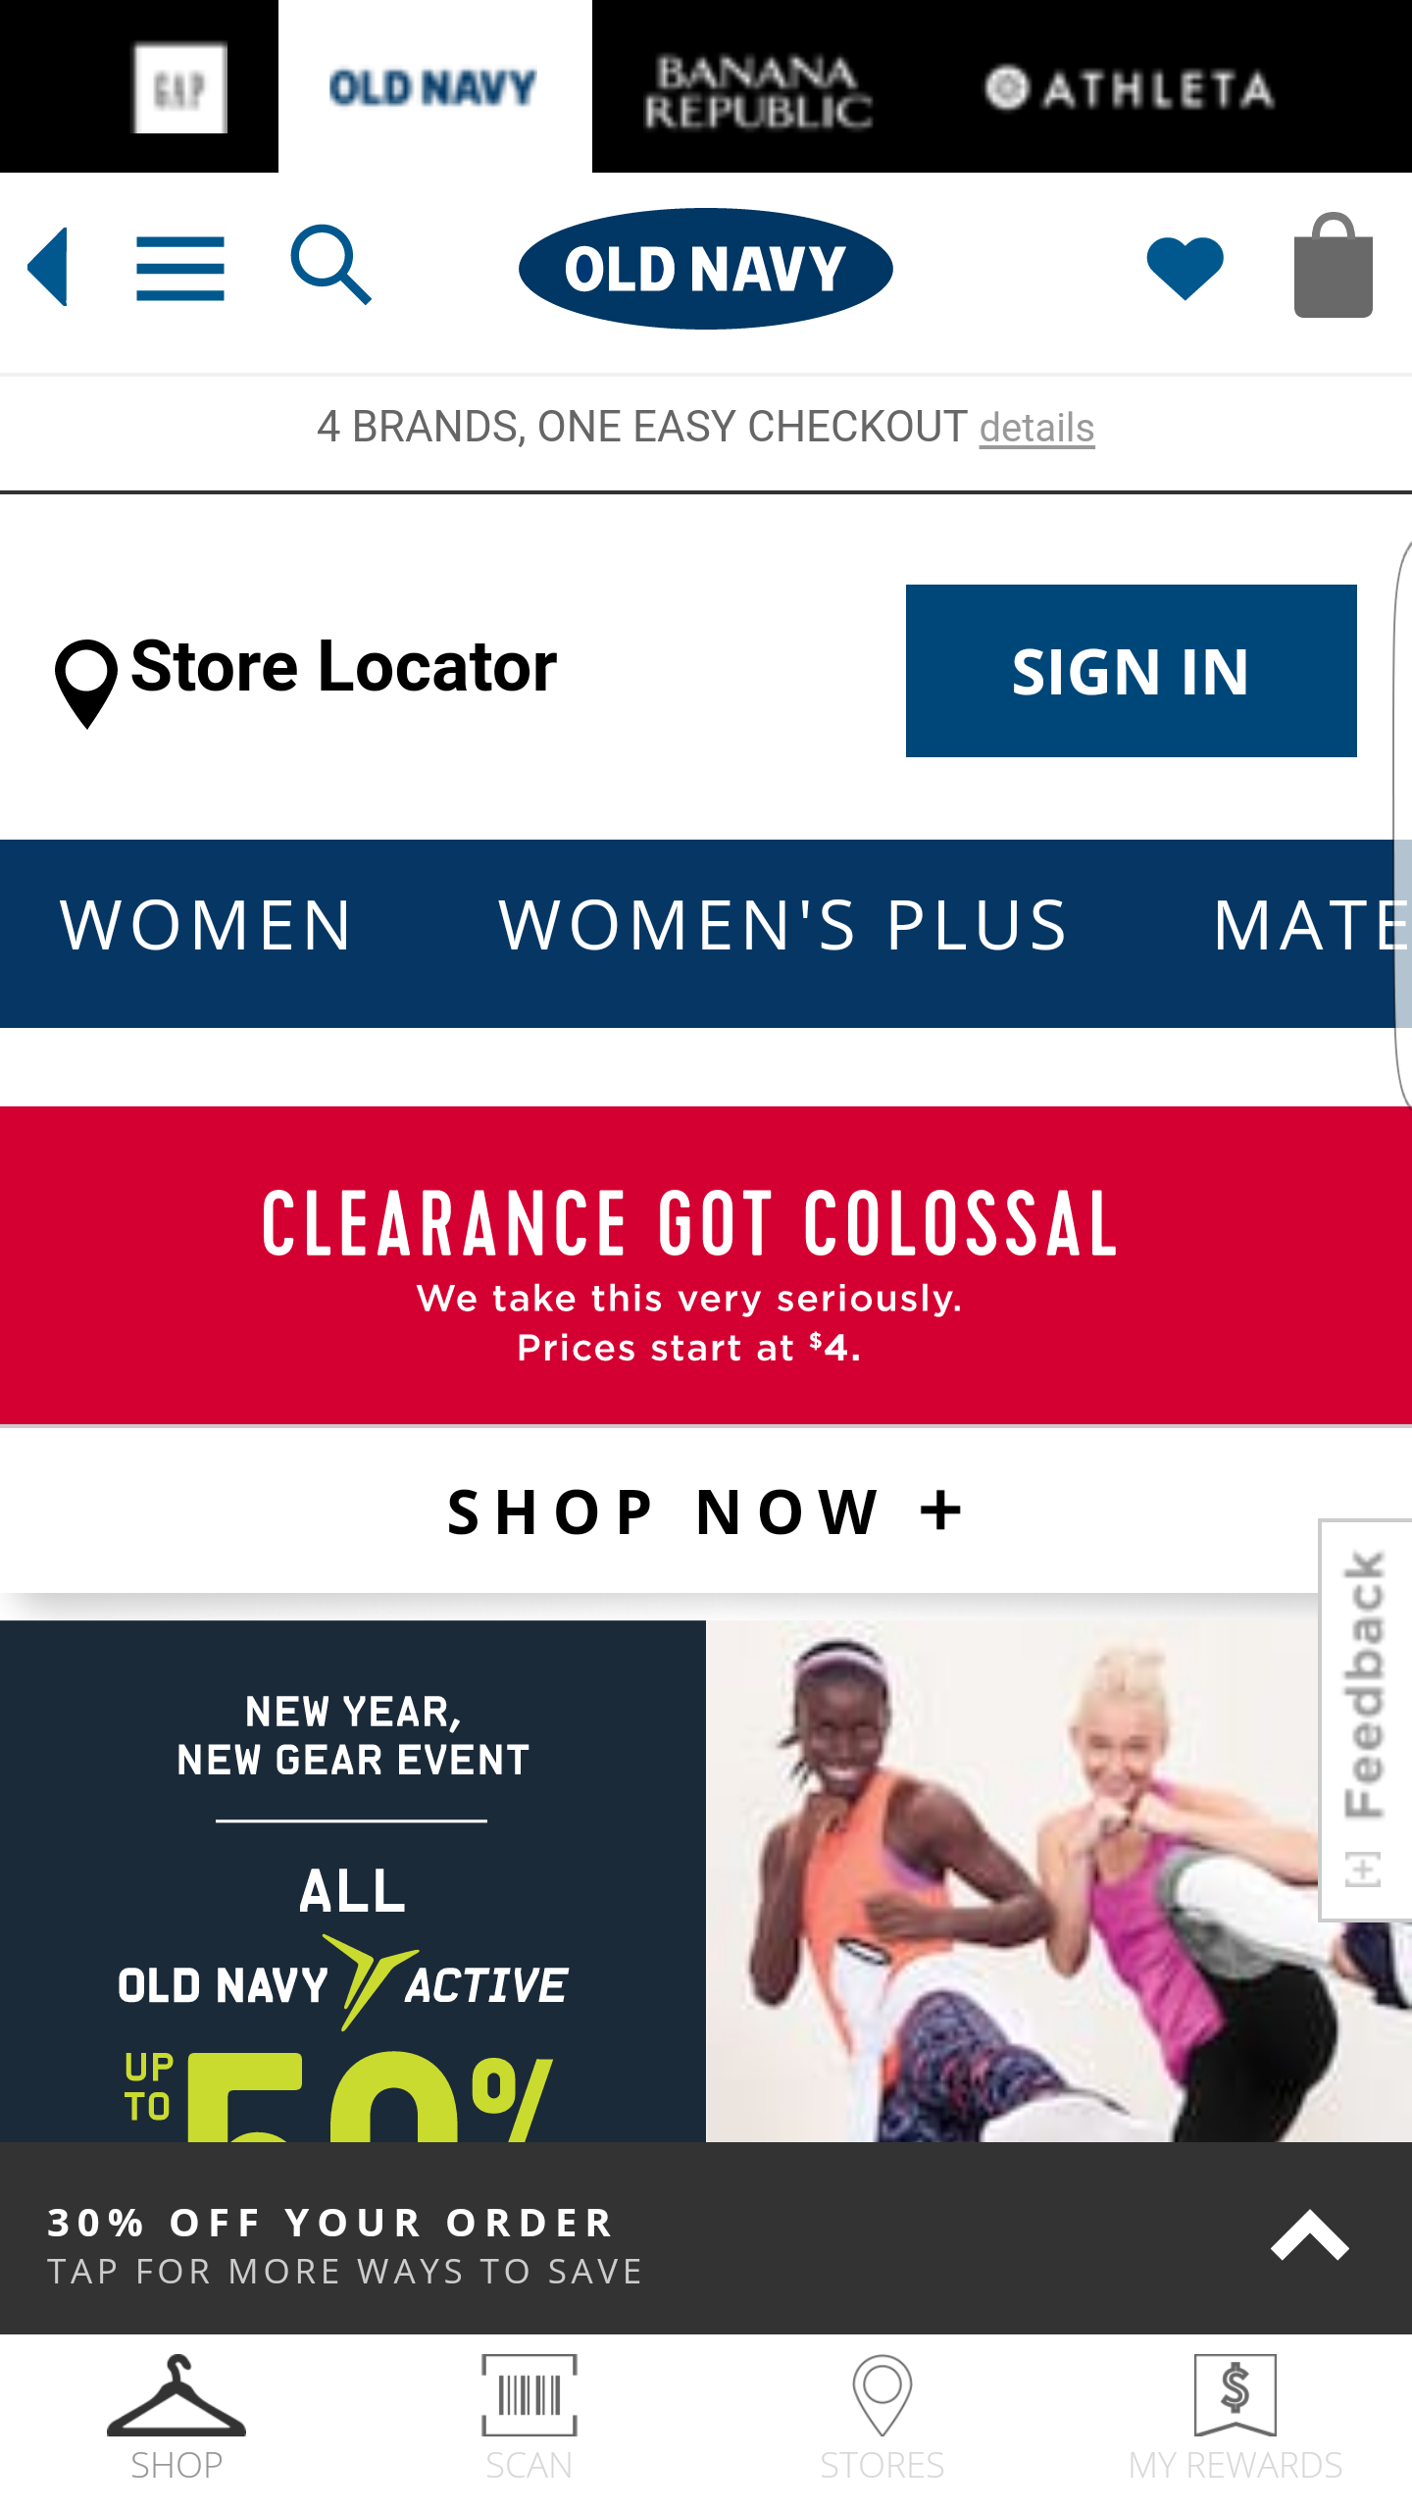
Gap, Inc. Retail Opportunities
Add contextual elements to Gap mobile apps and beacons in stores
Get in-store analytics such as dwell time and loiter areas
Data from device can trigger customized content to signage in stores, or at a later date via other touchpoints such as email and ads on other platforms (TVs, webpages).

Slide 25
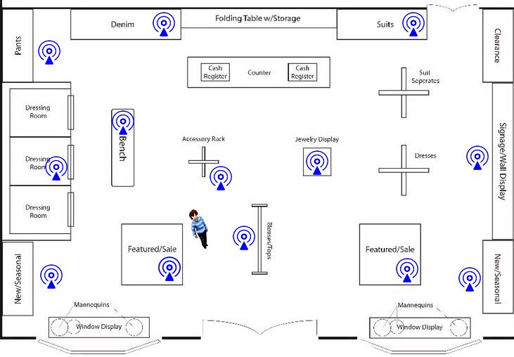
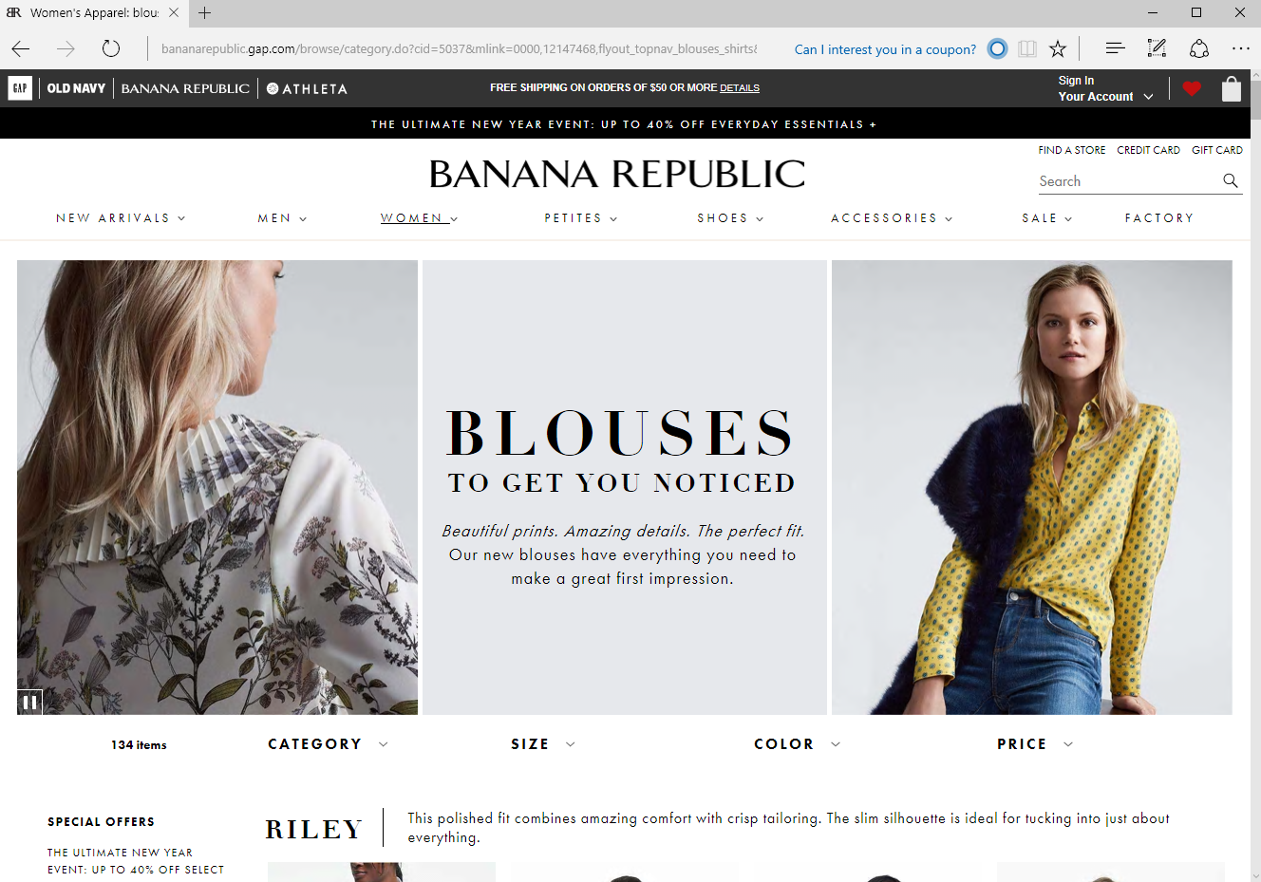
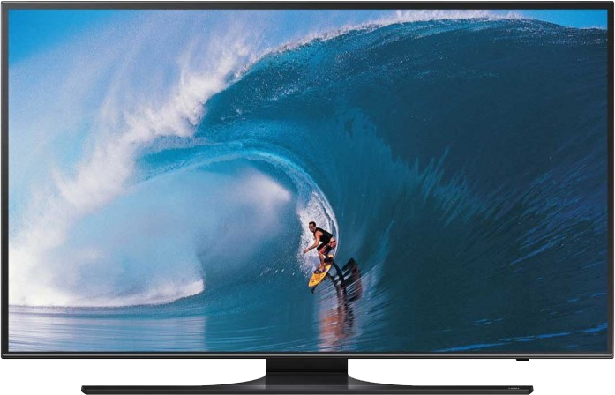
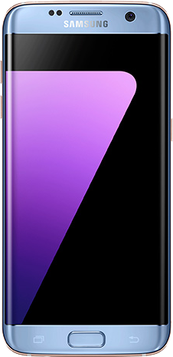
How it works

Slide 26
Additional capabilities
Store entry alert to sales staff to welcome customer
Dwell alert to sales staff to look for opportunity to offer assistance
Special offers for any given customer sent directly to their phone
Incentives to phone after longer dwell time possibly indicates indecision in making a purchasing decision
Automatically get in queue for dressing room if during busy time and alert customer when their turn is up

Slide 27
Post Visit opportunities
Behavior in store can feed back to future ad content and placement in app, web browser and on TV
Tailored content can be delivered to any device at any time

Slide 28
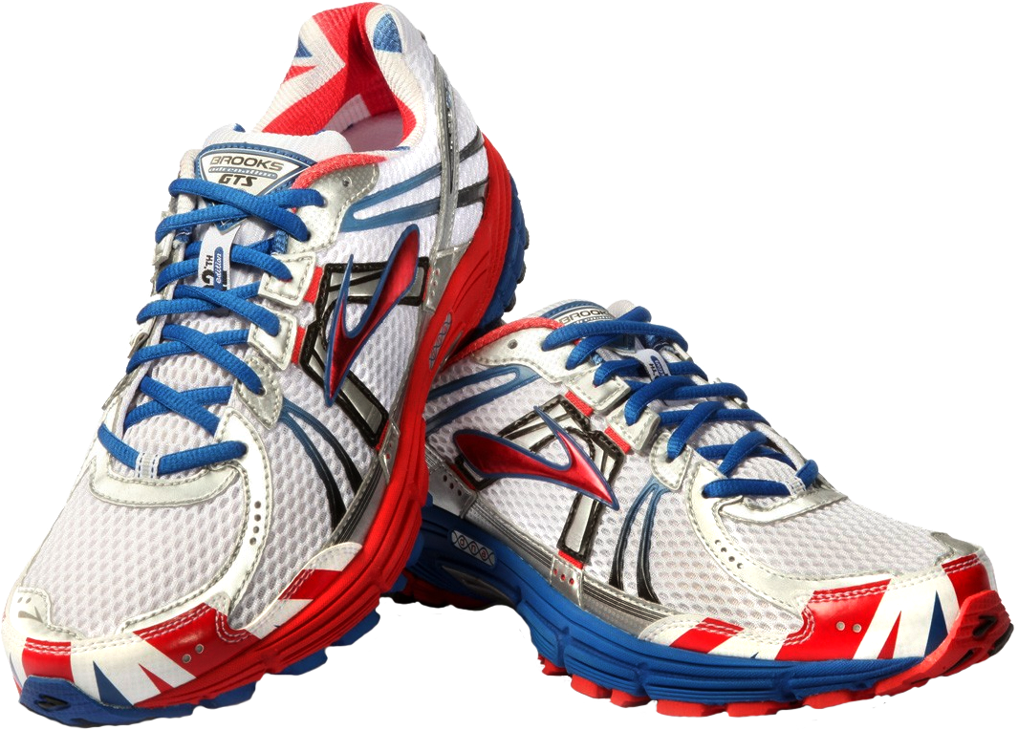
Activewear Opportunities
Fitness band can be preloaded with automated workout detection
Data on activity can be used to drive athletic clothing sales
Analytics can provide information such as which gyms customers work out at, which can then be used to forge new business relationships in related industries.
Quantification of workout can drive messaging to replace shoes at appropriate intervals

Slide 29
Thank you
Gap Innovation Summit
Jeffrey Cooper
Sr Mgr Business Development
Mt View, CA
Notes:
Role of technology intersection with fitness, making it personal

