Slide 1
The Internet of Things Following the Edge of Technology

Slide 2
Dr Luc Julia
Vice President, Innovation Fellow
Jeffrey Cooper
Sr Mgr Business Development

Slide 3
IoT Breakdown
Home
Body
Car
Business & Work (two perspectives)
Environmental & Civil

Slide 4
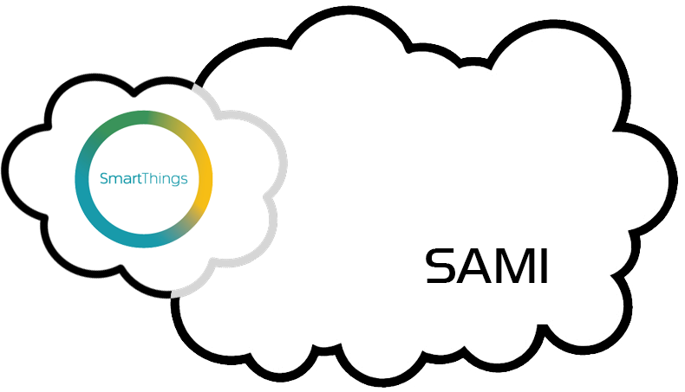
Samsung & IoT
Samsung’s involvement in the world of IoT accelerated in 2014
Launched Voice of the Body in May 2014, which includes SAMI- Samsung Architecture Multimodal Interactions
Bought SmartThings in August 2014
Increased development of interconnected products in 2014

Slide 5
Samsung & IoT
SmartThings allows for a strategy of bringing together all kinds of devices under one control element
SAMI allows for a strategy of bringing all kinds of data, device or other source, under a larger umbrella, to allow for powerful, contextual, life-changing scenarios for consumers that adopt them
Samsung makes a vast array of products, most are able to be “smartened”. Smartness will trickle down from flagship products downstream in the coming years.
Samsung’s informational devices, from TVs, tablets, phones to wearables, will form the first wave of incorporation of a Smart Home control panel.
SAMI capabilities will be able to bring context and decentralize control so that there are other ways to automate things due to value-added context, voice and alternate controls.

Slide 6
SmartThings CES Announcements
New version of hub- v2.0- April 2015
Addition of Cellular, BlueTooth Smart and WiFi
Addition of premium services for security- emergency calls to services and DVR service

Slide 7
SAMI Overview and CES updates
Dr Luc Julia

Slide 8
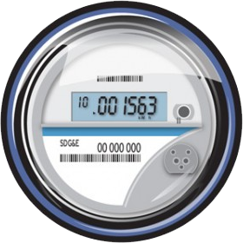
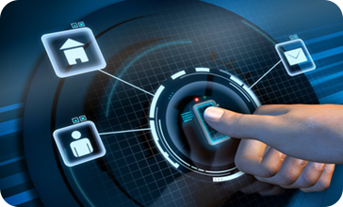
Literal
Shorter term realizations are more literal, such as energy and security
Lights and other types of notifications can reflect market performance, specific stock information, etc
Portfolio planning can be done in any room using voice and nearest display

Slide 9
Contextual
Contextual is more complex, requiring many data sources from sensors to databases
Many pieces of data coming together
Security of a home can have many different inputs- image, motion, fire, gas, hacking
Connected body can reflect overall health of the user and influence user to choose healthy alternatives and stay healthy

Slide 10
Consumer Impact
Consumers will greatly benefit from IoT adoption
Early scenarios will lower energy bills and improve personal security
Quantified health will have immediate consumer benefit with a healthier and happier you, saving money and increasing enjoyment of life.
Longer range scenarios will link together broad areas of life in ways never before possible
Maximum cost savings to the consumer will mean more ability to spend elsewhere, or save.

Slide 11
Quantified Body- Deep Dive
The ability to monitor and measure major aspects of health will be transformative
Mindfulness of oneself will lead to better health and cost savings
Integration with healthcare professionals will improve patient/doctor relationships and lead to better diagnoses and reduced healthcare costs

Slide 12
Quantified Body- In Depth
Tyler & Emma, twenty-somethings, are recently married and are planning to start a family. Tyler is sports competitive, Emma a professional and athletic herself.
Tyler tracks personal health parameters, such as diet, sleep, activity and daily biometric information. A combination of wearables and smart bedding, and other connected devices allow effortless tracking and recording of data.
Due to a past skiing injury, Tyler must be careful with his knees. Smart threading in undergarmets and knee brace allow joint performance to be quantified and alert him if it is being overworked.
Social integration of basic data introduces a competitive element for Tyler and an incentive to stay fit and improve his scores.

Slide 13
Quantified Body- In Depth
Tyler & Emma, twenty-somethings, are recently married and are planning to start a family. Tyler is sports competitive, Emma a professional and athletic herself.
Emma uses wearables, apps and eHealth monitoring by her personal physician to track fertility for optimum chance for conception.
After pregnancy begins, Emma tracks biometric health parameters, diet and sleep using apps, wearables and eHealth connection with her doctor for peace of mind and improved guidance and earlier detection of any anomalies.
As pregnancy progresses, diet and physical needs change and integration of daily routine with her doctor assures Emma’s pregnancy is as optimal as possible.

Slide 14
Quantified Body- In Depth
Tyler & Emma, twenty-somethings, are recently married and are planning to start a family. Tyler is sports competitive, Emma a professional and athletic herself.
Additional benefits arise from living a quantified life. Integration with doctors and insurance companies can lead to substantial cost savings as real risks are now quantifiable, and those who live healthier lives can pay lower premiums.
As they raise a family, parents can help their kids stay healthy from a young age. Integration with pediatrician health systems will ensure best-in-class care when sickness or injuries happen.

Slide 15
Quantified Body- In Depth
Tom & Sharon are empty-nesters in their mid-50’s with elderly parents. Conscious of their own advancing ages, they take a keen eye on their parents’ health while keeping healthy themselves.
Tom & Sharon monitor their own health, food and sleep with smart bedding and a wearable, plus a connected scale. Sharon has an additional walking/activity regimen, plus modified diet, to ward off osteoporosis, which runs in the family.
Both have regularly scheduled physicals and checkups, regularly-recommended cancer screenings, and are integrated with their doctor’s eHealth system. Visits to the doctor are augmented with lifestyle history and data for more accurate diagnoses and recommendations.

Slide 16
Quantified Body- In Depth
Tom & Sharon are empty-nesters in their mid-50’s with elderly parents. Conscious of their own advancing ages, they take a keen eye on their parents’ health while keeping healthy themselves.
Tom & Sharon still have their parents. Sharon’s parents are older, and both want to ensure their parents’ golden years are healthy and happy.
Each has access to overall health data for their parents, and both sets of parents have wearable devices to both monitor for activity (or lack thereof) as well as fall detection. Proximity and motion sensors in the home can augment the data.
Data from the parent’s wearables and are integrated with their doctor’s eHealth system for passive and active monitoring, allowing early detection of problems.
Smart Fridge and Smart Pantry allow monitoring of food supplies for the older parents, and screens in various areas of both homes allow seamless communications when desired.

Slide 17
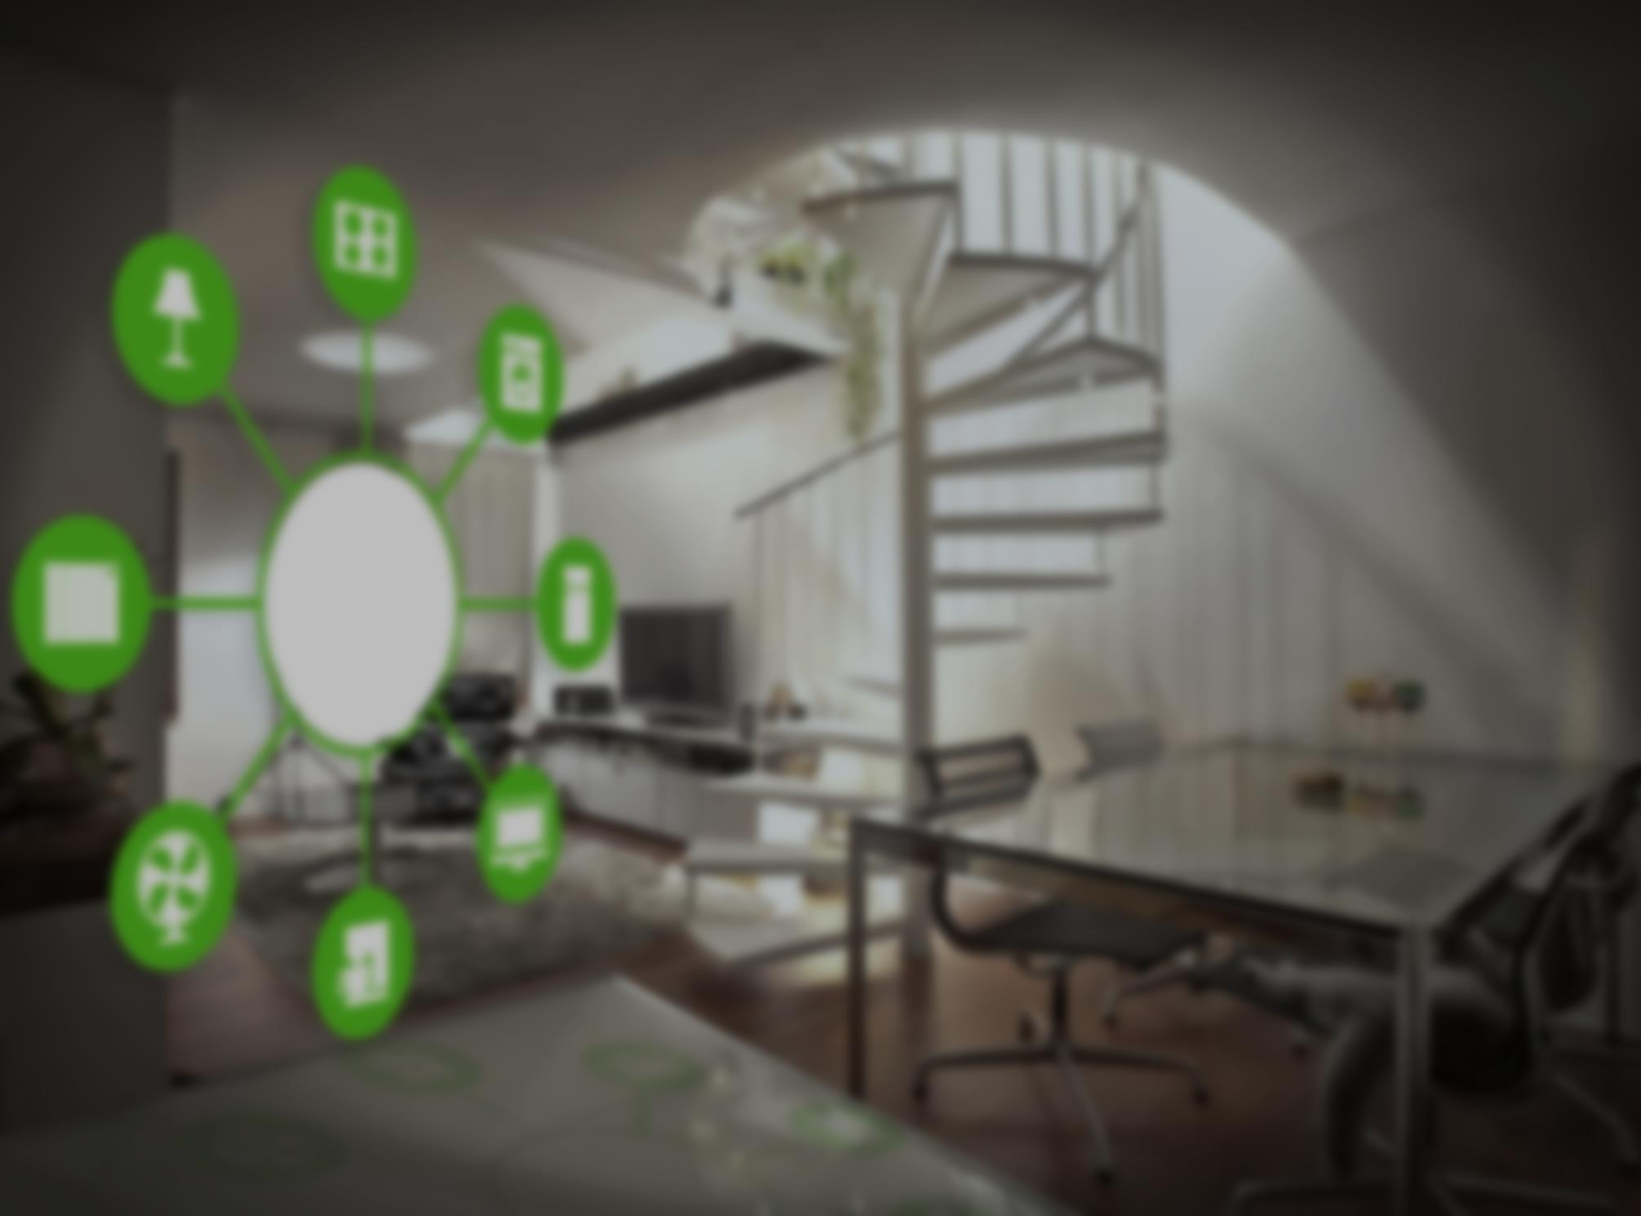
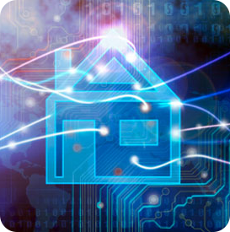
Smart Home- Deep Dive
Basic Tenets
There will be a profusion of connected devices
Security and Energy Efficiency will be drive uptake initially
Smart Home intersects Connected Car and Quantified Self
Data gathered and generated in the home will need Big Data for context
It’s about anticipation, context and personalization- it “just is” and “just does”

Slide 18
Smart Home- In Depth
Vastly improved security systems will allow smart presence, image recognition, indoor and outdoor
Monitoring via multiple communications path ensures connectedness in event of an emergency
Remote monitoring and situation management from anywhere in the world.
Personal and Home security, Fire and Medical are integrated
Integration of monitoring systems with insurance results in proper risk management and lower rates for lower risk customers.

Slide 19
Smart Home- In Depth
Vastly improved energy management will allow substantial control over energy usage and maximal cost savings
Smart Metering, time-based peak pricing and time shifting usage will become common
Smart Presence and individual recognition will allow optimal heating and air conditioning based on actual room usage and features like follow-me lighting
Integration with local weather will allow predictive and optimal responses to rapidly changing weather conditions.
Smart Devices will monitor their own power usage and optimize to save money and go into standby when not needed or no presence.

Slide 20
Smart Home- In Depth
Intersection of quantified self and smart home will affect environmental controls- e.g., change temperature during a workout
Bedtime triggers can adjust lighting, security and environmental controls to nighttime mode, and enable coffee pot and buffering of morning newscast
Health parameters can be utilized by Smart Kitchen to suggest healthier recipes. Food eaten can be tracked and diet guidance adapted accordingly.
Full inventory of products through Smart Packaging allow instant notifications of product recalls, including account credits, shipping or replacements or scheduling of repairs.
Overall family health increased by integration of quantified self and the smart home.

Slide 21
Smart Home- In Depth
Intersection of Connected Car with Smart Home and Quantified Self will further improve multiple scenarios.
Monitoring of health parameters can detect sleepiness or other major health issues and alert the driver or take over operation of the vehicle in dire circumstances and guide to safety.
Vehicle usage and performance parameters meticulously recorded will allow better maintenance and diagnoses, leading to lower operational and potentially lower insurance costs.
Integration with Smart Home energy management will allow optimal recharging of vehicle batteries when electricity prices are lowest. Alternately, vehicle batteries can act as reserve power in the event of emergencies or peak usage.
Driver authentication through biometric data reduces theft risk
Dash system integration brings personal preferences and context to the driving experience.

Slide 22
Discussion, Q&A

