Slide 1

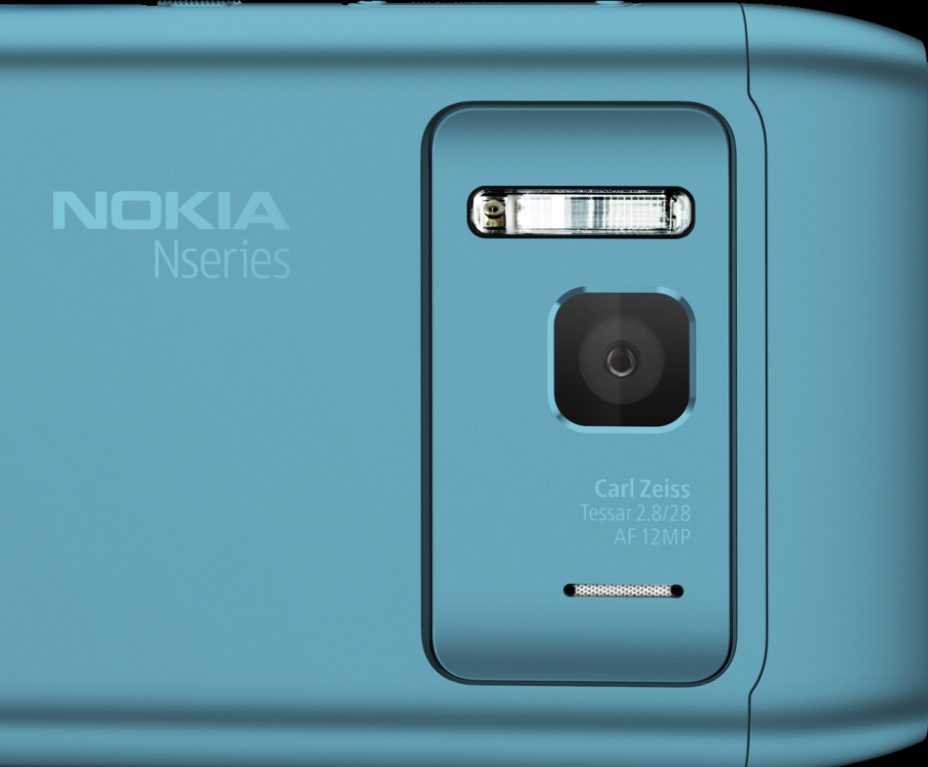
Mobile Cinematography
Nokia N8

Slide 2
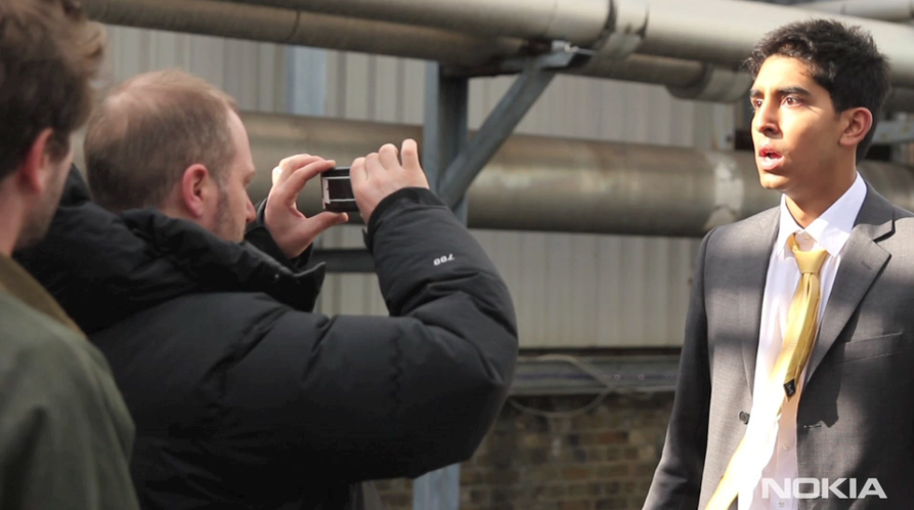

Slide 3

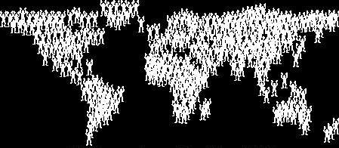
Small Team
Millions
Kari Nevil
Creation
Marketing & Distribution
Why are we here?

Slide 4
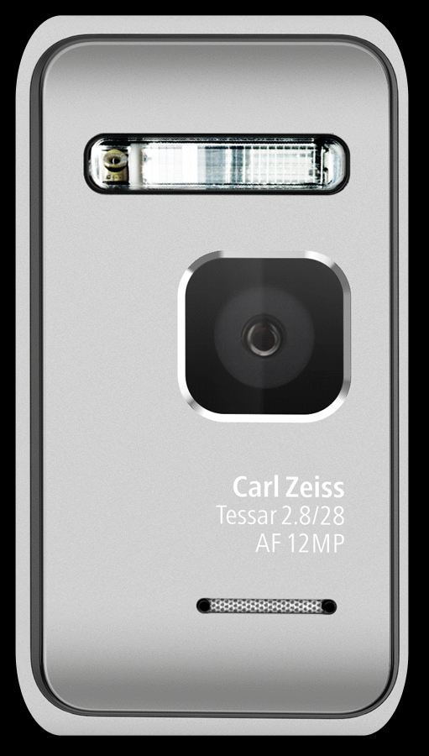
12 megapixels
Carl Zeiss optics
28mm wide angle, f2.8
photo
Autofocus
Macro mode
Xenon Flash
Sensor size 1/1.83”
720p
25fps
3Ofps
video
HDMI out
Dolby 5.1 audio out
H.264, MPEG-4, VC-1, H.263
RV10, ON2 VP6, Flash

Slide 5
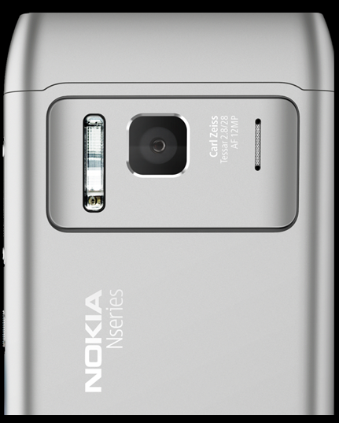
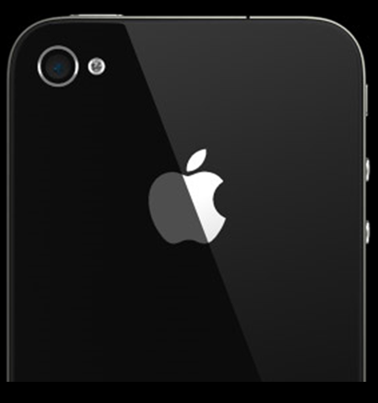

Slide 6
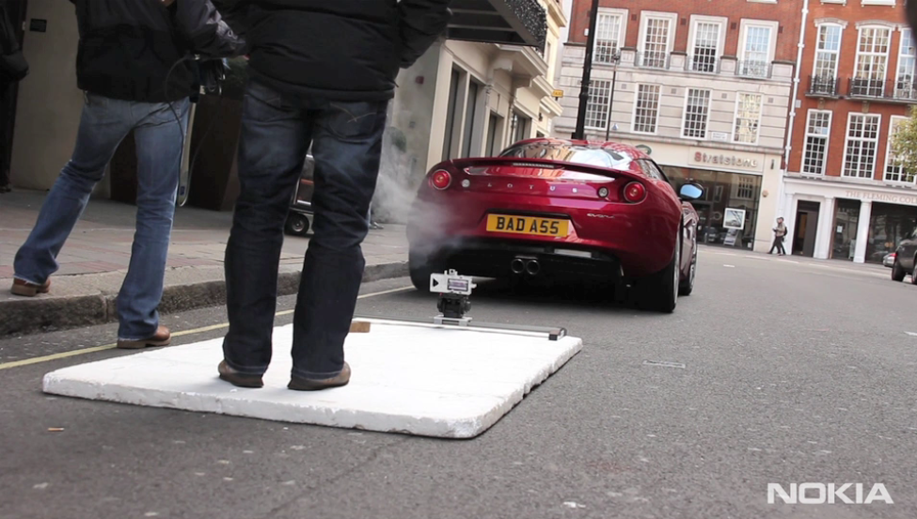

Slide 7
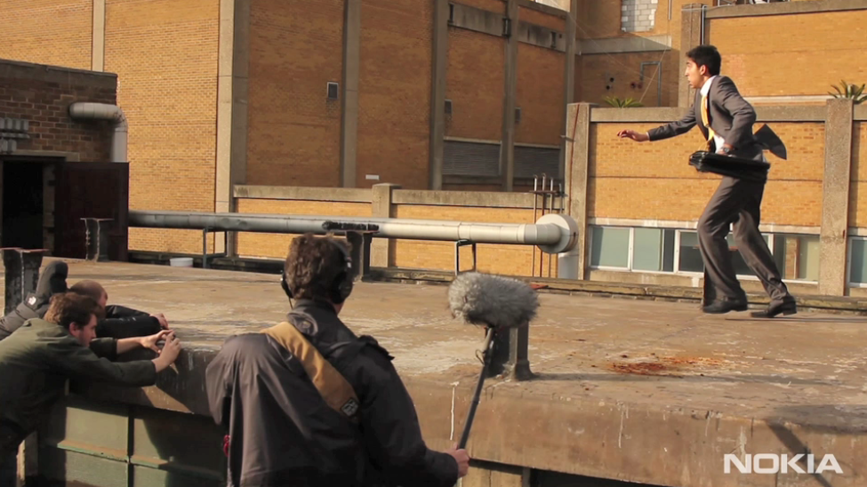

Slide 8
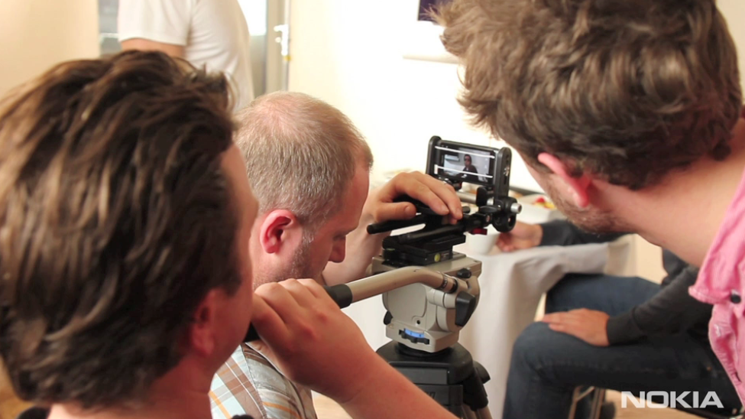

Slide 9
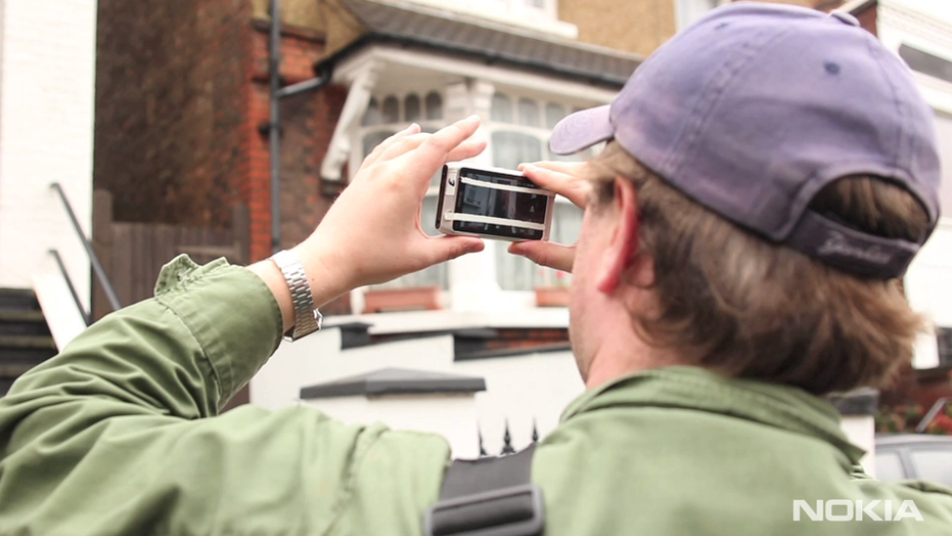

Slide 10
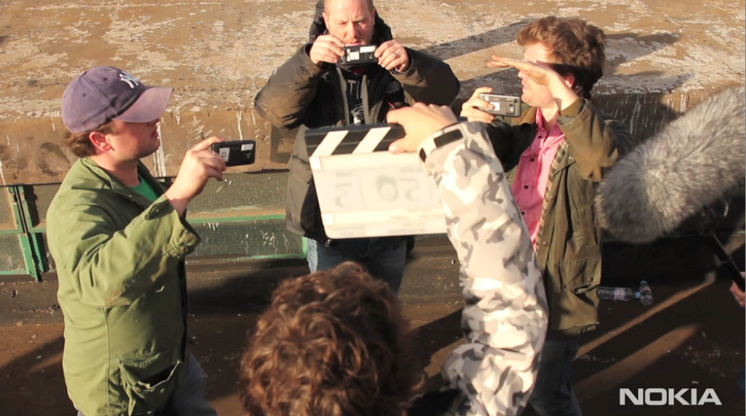

Slide 11
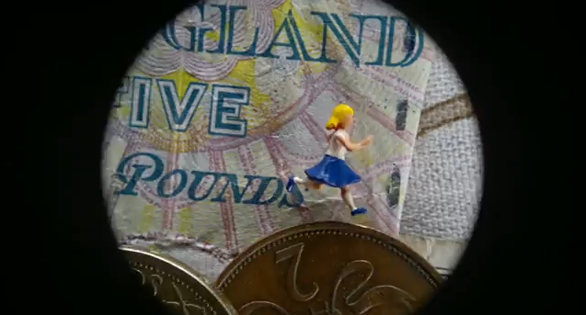
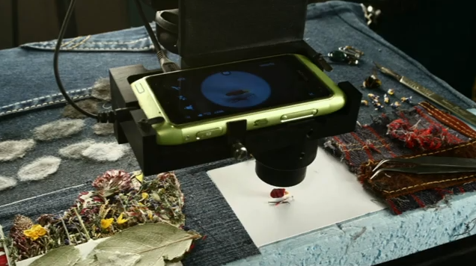
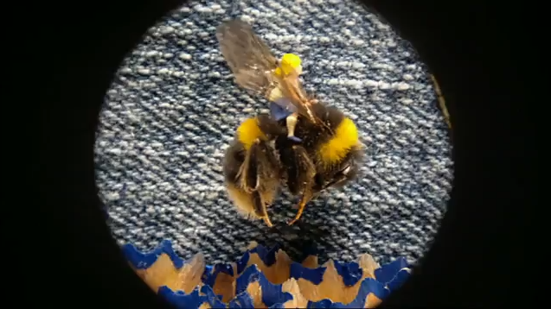
dot on vimeo

Slide 12
Intro to Kari Nevil

Slide 13
Small Team
Creation

Slide 14
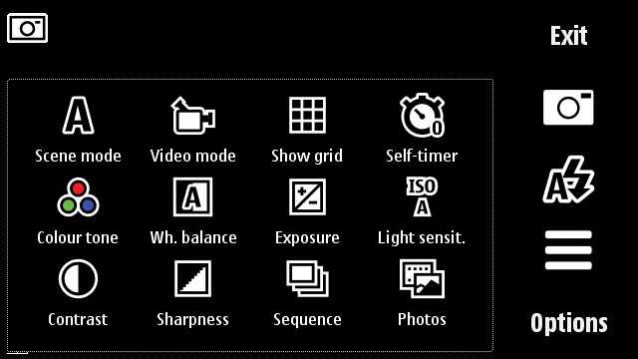
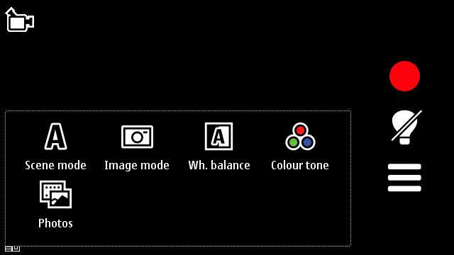
photo
video
out of the box

Slide 15
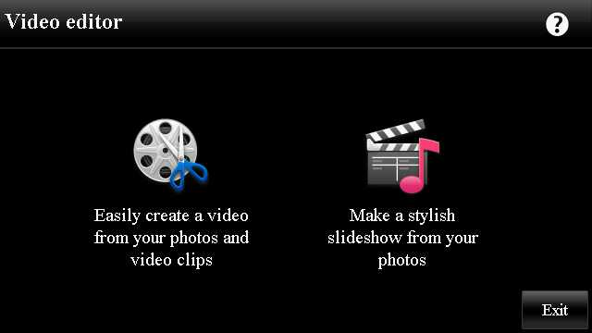
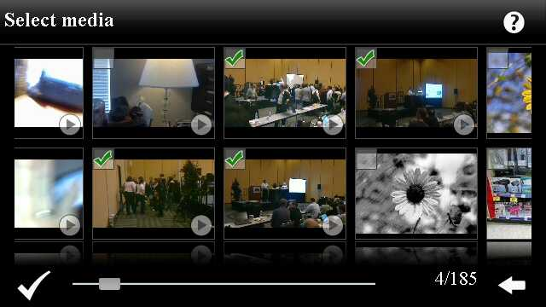
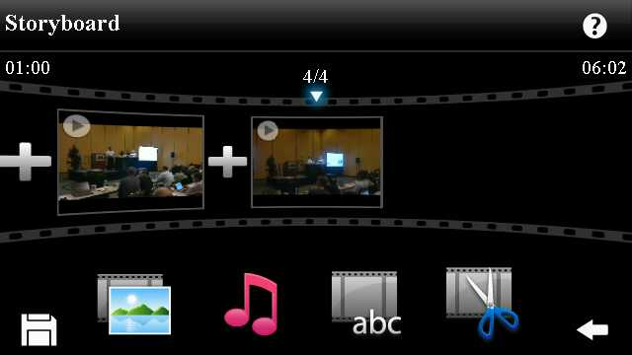
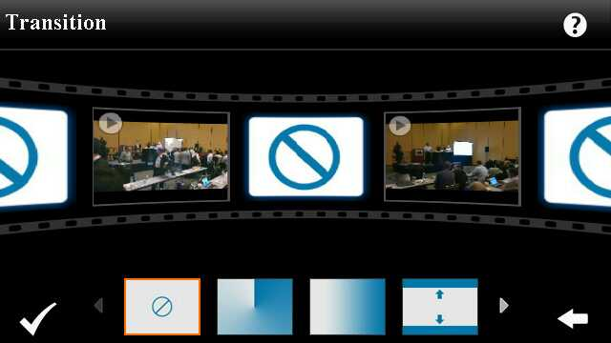
ArcSoft video editor

Slide 16
Intro to BLStream
Anton Gauffin
ShutterPro & VideoPro

Slide 17
Intro to LiveCast
William Mutual

Slide 18
Intro to Port Nexus
Paul Gaylie

Slide 19
Intro to Project Box
Tim Garrett

Slide 20
Discussion & Questions

Slide 21
Millions
Marketing & Distribution

Slide 22
Intro to iMatte
Paul Vlahos

Slide 23
Intro to Qvew
Eric Sanchez

Slide 24
Distribution

Slide 25
Discussion & Questions

Slide 26
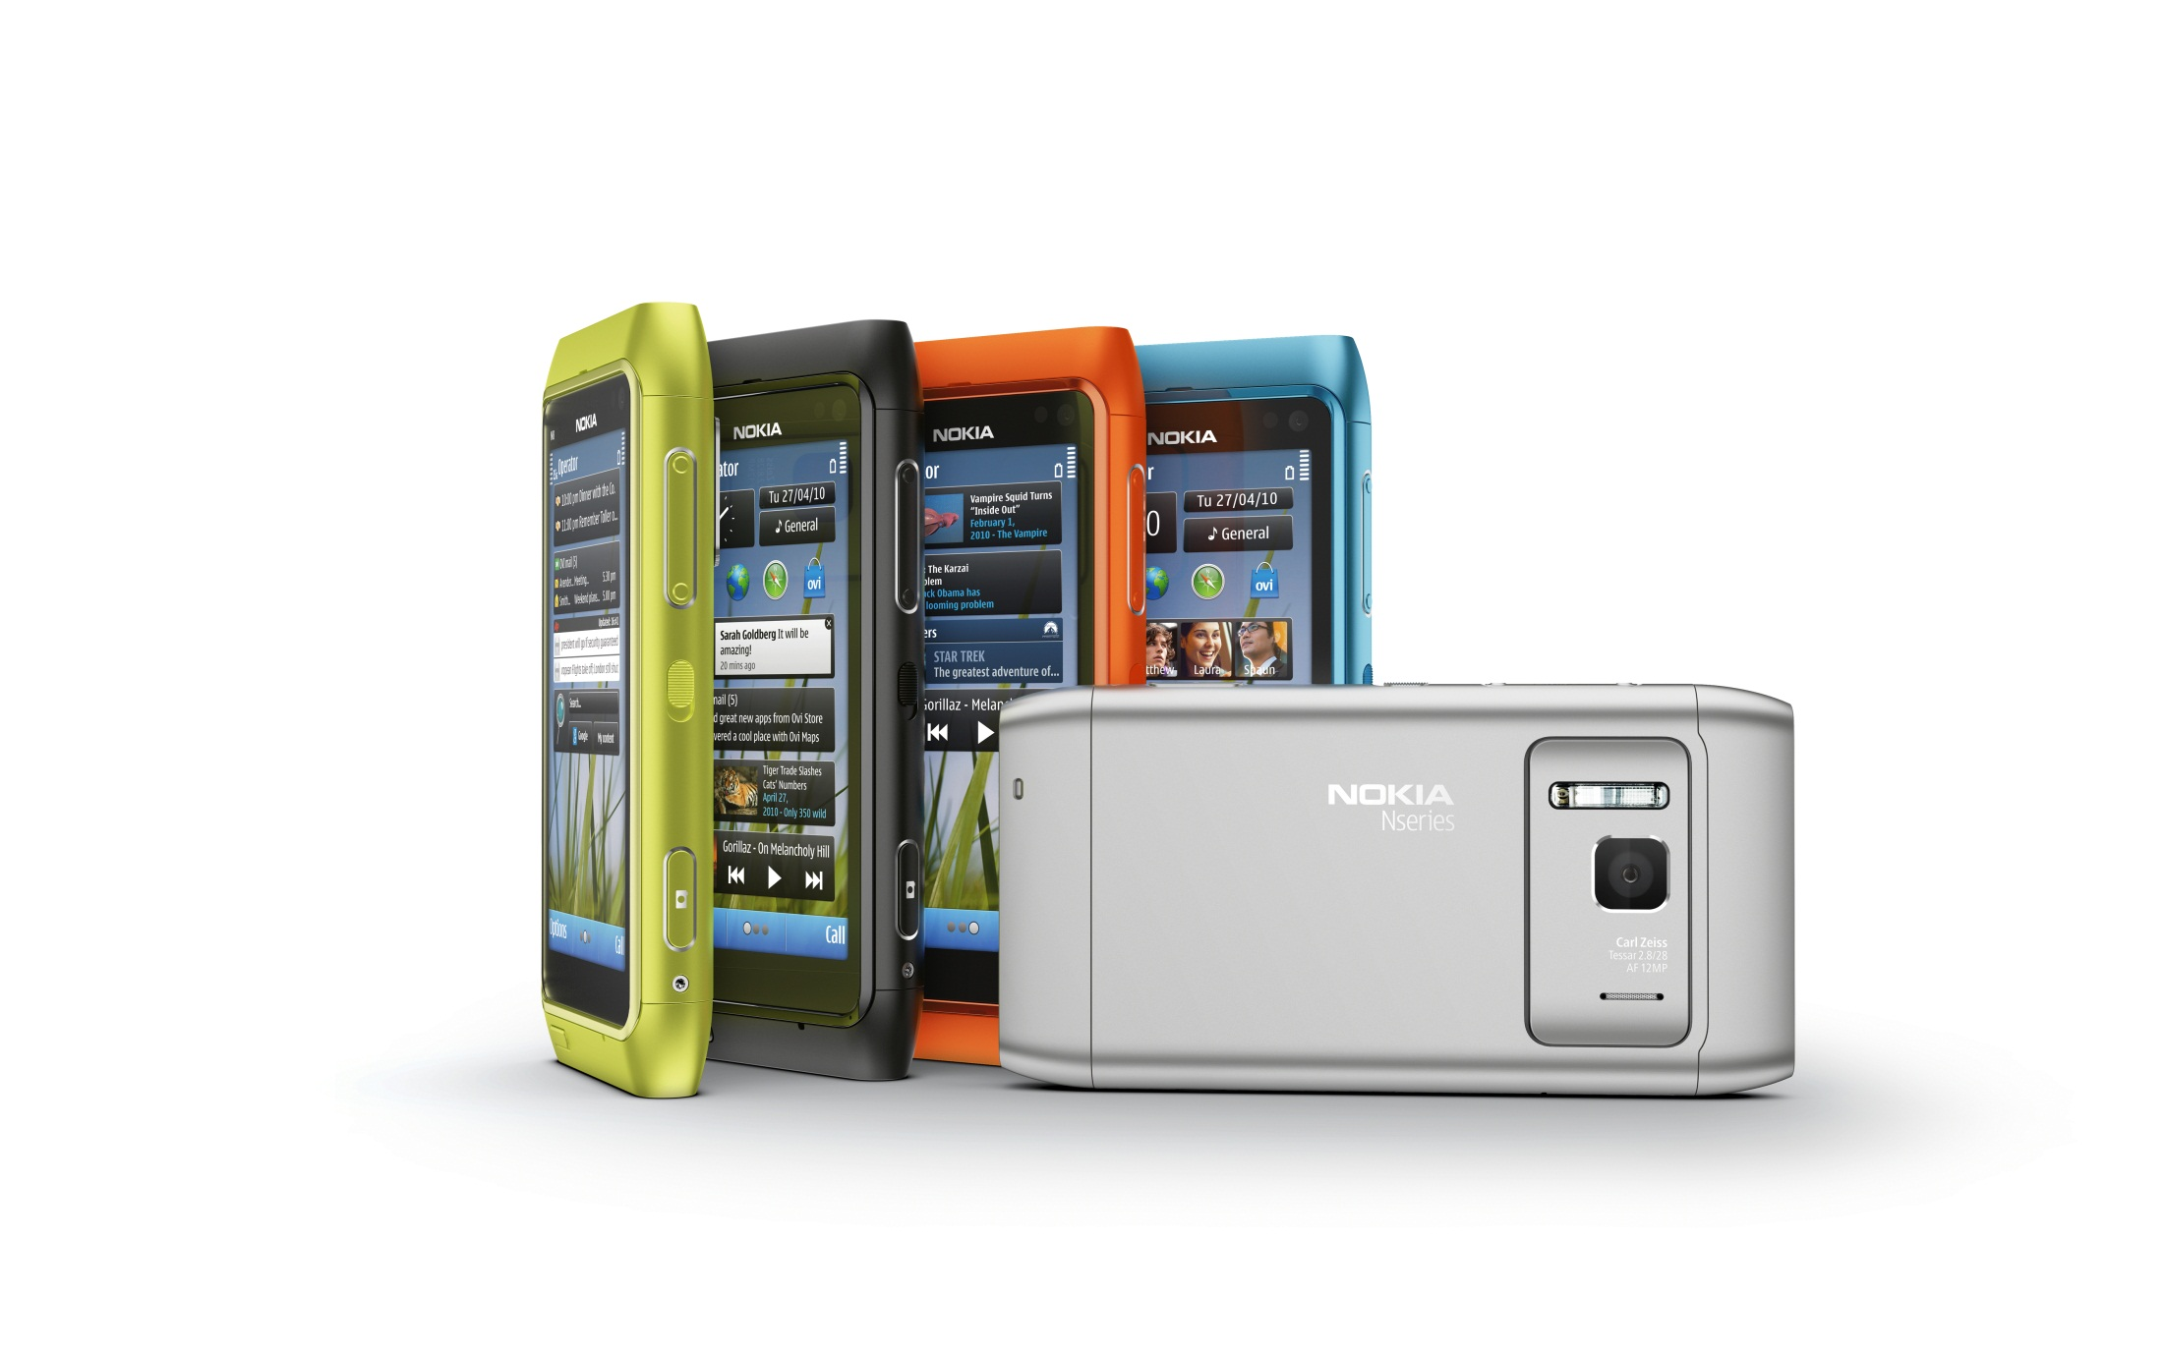
Mobility is a tool.
Use it.

Slide 27
ShutterPro & VideoPro
MixItUp apps
LiveCast
Sh@re
QVR Voice Recorder
Direct Distribution
Associate
Pocketbooth
Available or available soon in Ovi

Slide 28
Available at Fry’s
and Amazon
Join us in the VIP lounge at the
Fairmont Hotel, where we will be
having a drawing and giving away
N8 devices!

